Slide 1
Online Planning in MDPs
Tom Silver
Robot Planning Meets Machine Learning
Princeton University
Fall 2025

Slide 2
Recap and Preview
Last lecture, we considered computing policies for MDPs.
A policy assigns an action to every state in the MDP.
Complexity of computing/storing a policy is at least linear in the number of states. For large MDPs, this is a dealbreaker.
This time, we will suppose that an initial state is known.
How can we use knowledge of an initial state to reduce complexity?
Partial policies: partial assignment of states to actions

Slide 3



The Factory and the Wild
Let’s make a robot startup!
Factory
Wild
Shipping

Slide 4
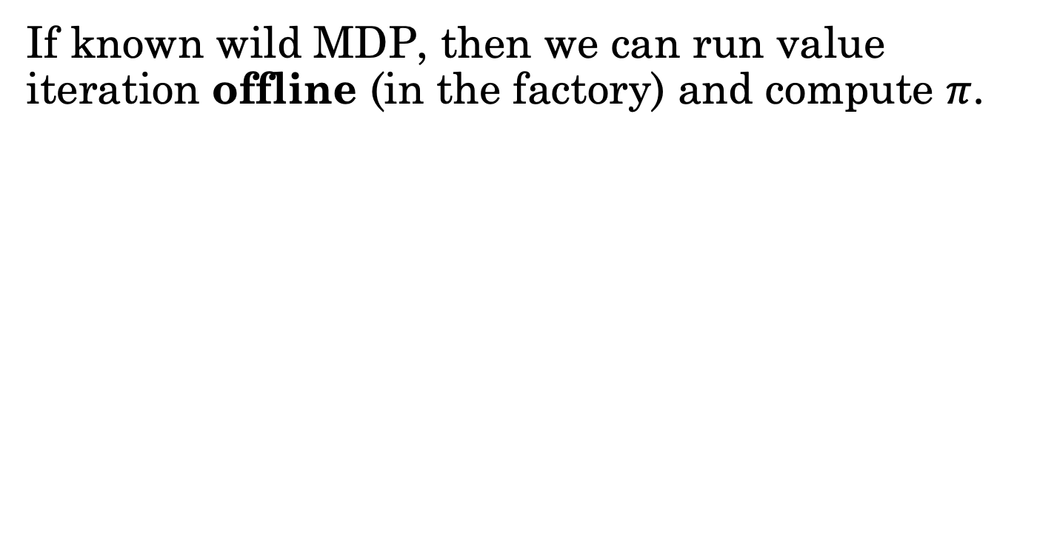
Planning Offline (In the Factory)
If known wild MDP, then we can run value iteration offline (in the factory) and compute $π$.

Slide 5
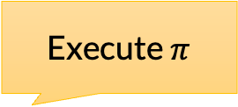
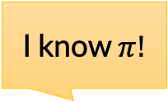
Planning Offline (In the Factory)
If known wild MDP, then we can run value iteration offline (in the factory) and compute $π$.
Run value iteration once
I know $π!$
Execute $π$
Factory
Wild
Shipping

Slide 6
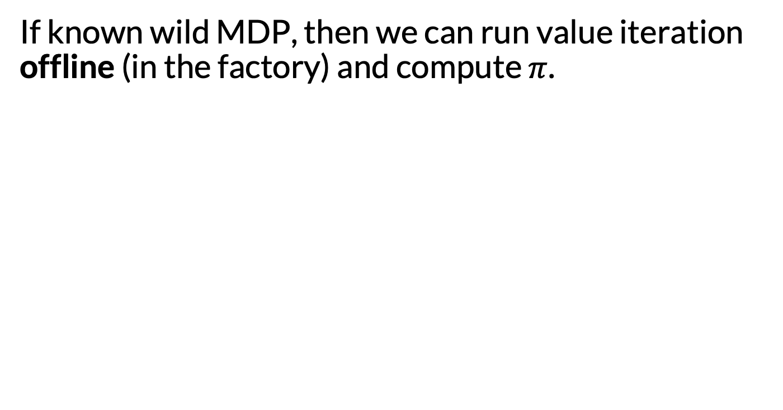
Planning Offline (In the Factory)
If known wild MDP, then we can run value iteration offline (in the factory) and compute $π$.
When might this be a good or bad idea?
Run value iteration once
I know $π!$
Execute $π$
Factory
Wild
Shipping

Slide 7
Planning Online (In the Wild)
Alternatively, we could ship the robot with the MDP, and have it plan online (in the house).

Slide 8
Planning Online (In the Wild)
Alternatively, we could ship the robot with the MDP, and have it plan online (in the house).
Don’t plan at all
I know MDP!
Plan in MDP
Factory
Wild
Shipping

Slide 9
Planning Online (In the Wild)
Alternatively, we could ship the robot with the MDP, and have it plan online (in the house).
Don’t plan at all
I know MDP!
Plan in MDP
Key idea: upon arrival in the wild, robot knows its current state.
Factory
Wild
Shipping

Slide 10
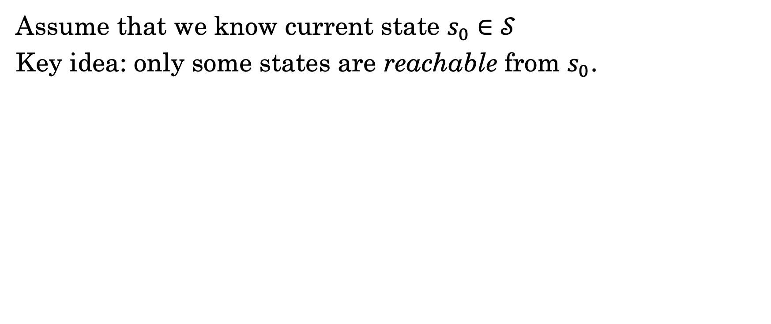
Leveraging Known Current State
Assume that we know current state $s_{0}∈𝒮$
Key idea: only some states are reachable from $s_{0}$.

Slide 11
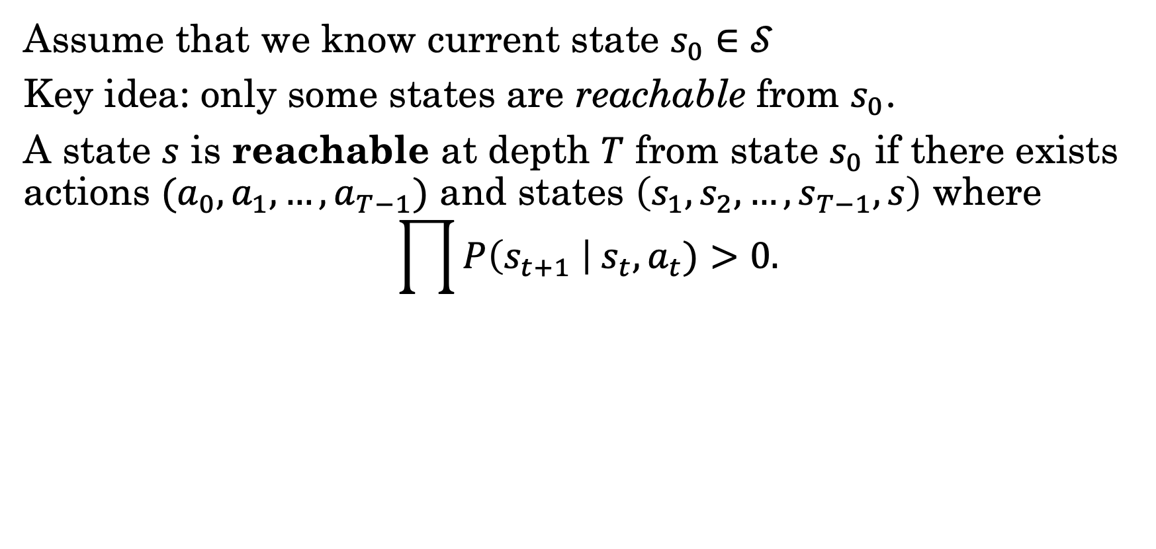
Leveraging Known Current State
Assume that we know current state $s_{0}∈𝒮$
Key idea: only some states are reachable from $s_{0}$.
A state $s$ is reachable at depth $T$ from state $s_{0}$ if there exists actions $(a_{0}, a_{1}, …,a_{T−1})$ and states $\left(s_{1}, s_{2},…, s_{T−1}, s\right)$ where
$$\prod{P\left(s_{t+1} \right| s_{t}, a_{t})>0.}$$

Slide 12
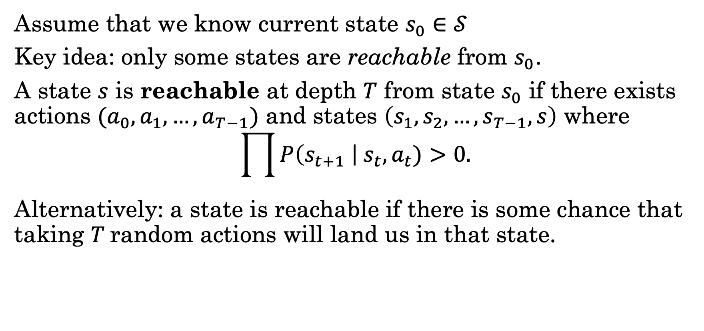
Leveraging Known Current State
Assume that we know current state $s_{0}∈𝒮$
Key idea: only some states are reachable from $s_{0}$.
A state $s$ is reachable at depth $T$ from state $s_{0}$ if there exists actions $(a_{0}, a_{1}, …,a_{T−1})$ and states $\left(s_{1}, s_{2},…, s_{T−1}, s\right)$ where
$$\prod{P\left(s_{t+1} \right| s_{t}, a_{t})>0.}$$
Alternatively: a state is reachable if there is some chance that taking $T$random actions will land us in that state.

Slide 13
Leveraging Known Current State
Assume that we know current state $s_{0}∈𝒮$
Key idea: only some states are reachable from $s_{0}$.
A state $s$ is reachable at depth $T$ from state $s_{0}$ if there exists actions $(a_{0}, a_{1}, …,a_{T−1})$ and states $\left(s_{1}, s_{2},…, s_{T−1}, s\right)$ where
$$\prod{P\left(s_{t+1} \right| s_{t}, a_{t})>0.}$$
Alternatively: a state is reachable if there is some chance that taking $T$random actions will land us in that state.
How can we efficiently compute reachable states?
How can we leverage reachable states for planning?

Slide 14
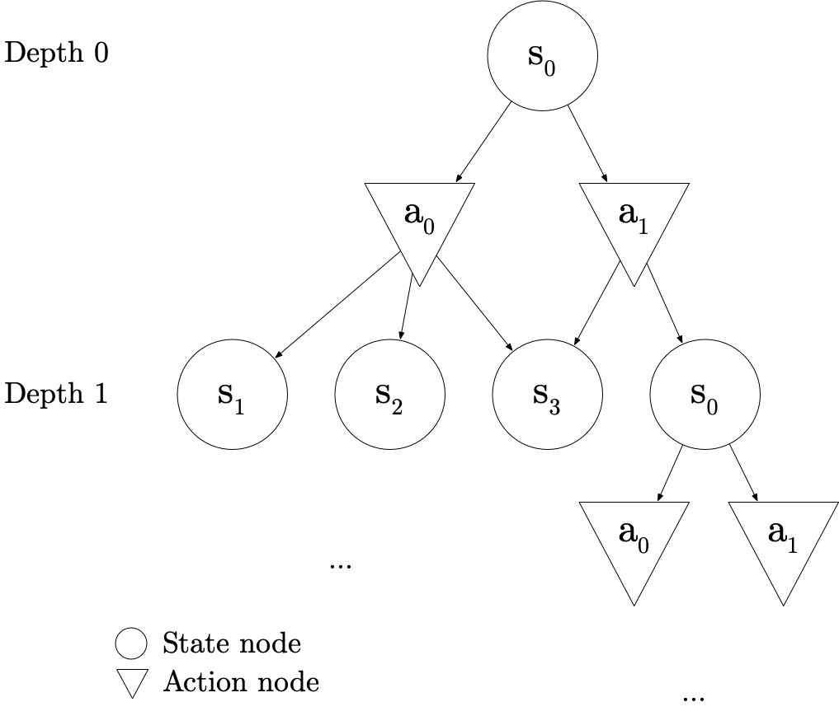
And-Or Directed Acyclic Graphs
And-Or DAGs (AODAGs)
State nodes
Action nodes
Children of state nodes: one per action
Children of action nodes: one per possible next state
Nonzero probability

Slide 15
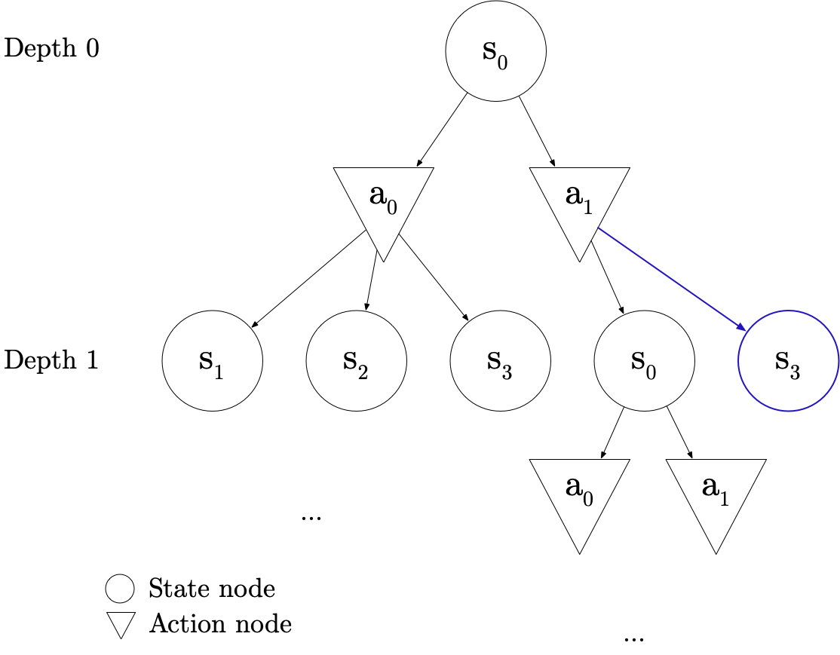
Warning: I Just Made Up AODAGs
Usually, just a tree
But then we could have duplicate (state, depth)
Their subtrees would be duplicated too
Everything will be fine – we may just do redundant computation

Slide 16
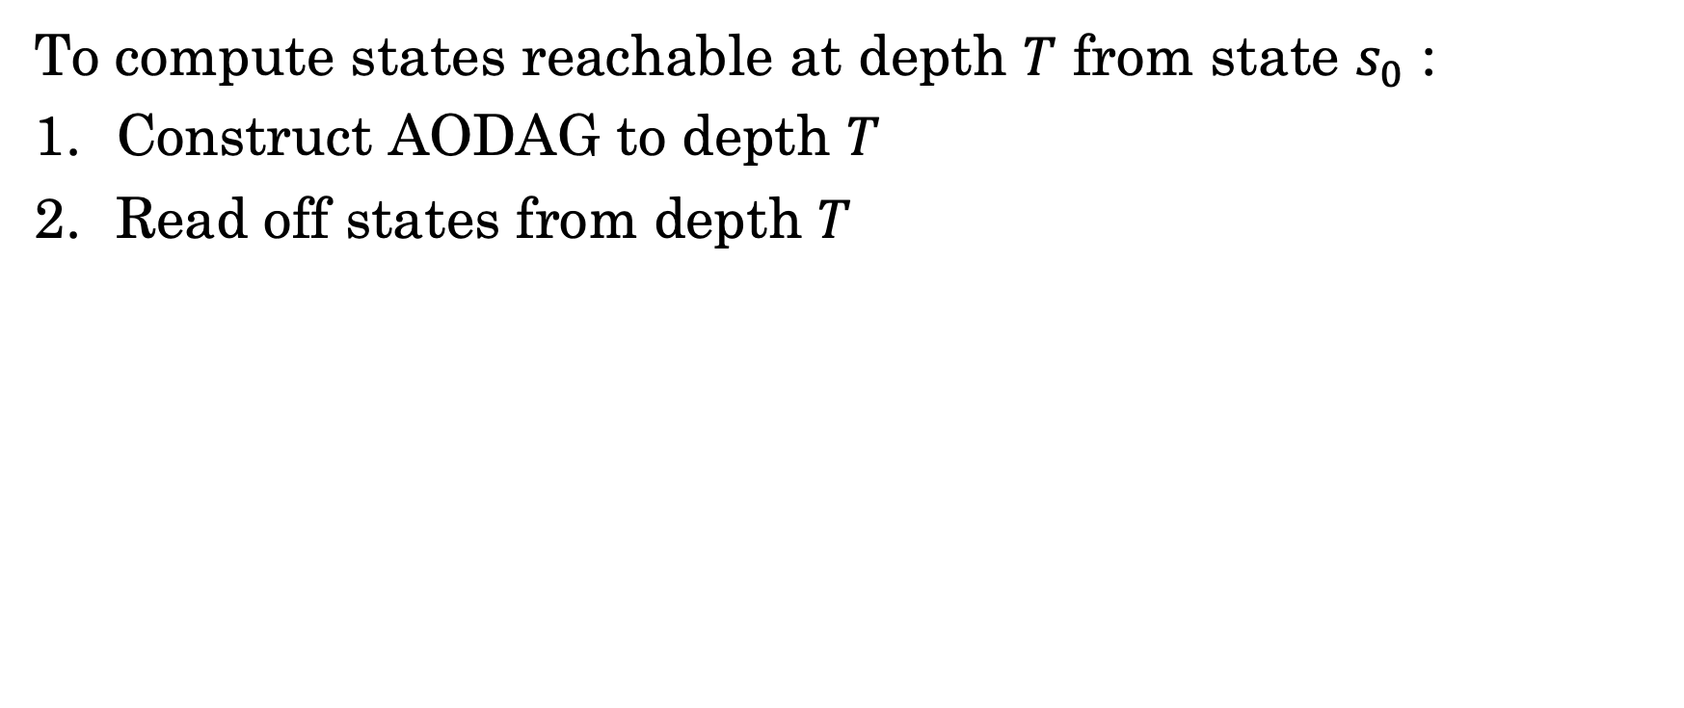
Finding Reachable States: Finite Depth
To compute states reachable at depth $T$ from state $s_{0}$ :
Construct AODAG to depth $T$
Read off states from depth $T$

Slide 17
Finding Reachable States: Finite Depth
To compute states reachable at depth $T$ from state $s_{0}$ :
Construct AODAG to depth $T$
Read off states from depth $T$
True or False: if a state is reachable at depth 1, it must also be reachable at depths > 1.

Slide 18
Using Reachable States: Finite Depth

Slide 19
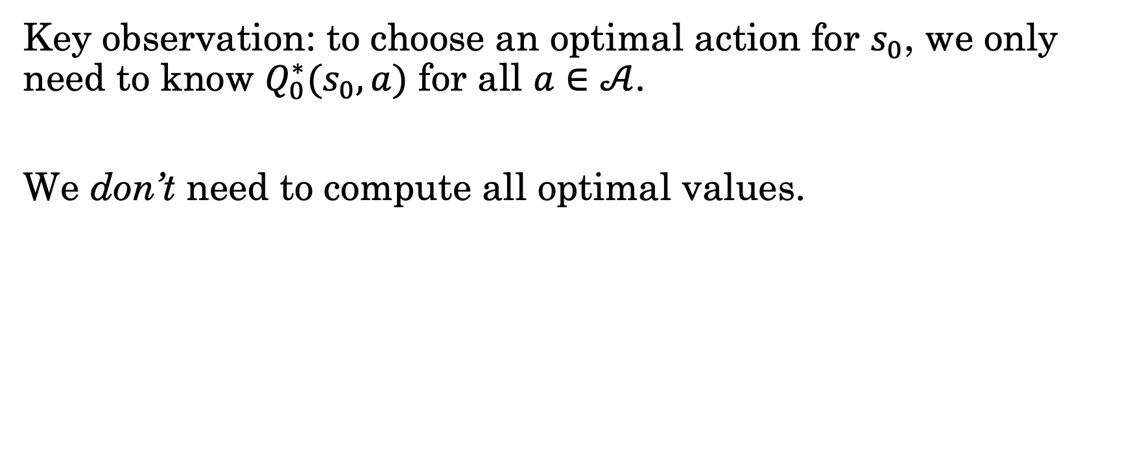
Using Reachable States: Finite Depth
Key observation: to choose an optimal action for $s_{0}$, we only need to know $Q_{0}^{∗}(s_{0}, a)$ for all $a∈𝒜$.
We don’t need to compute all optimal values.

Slide 20
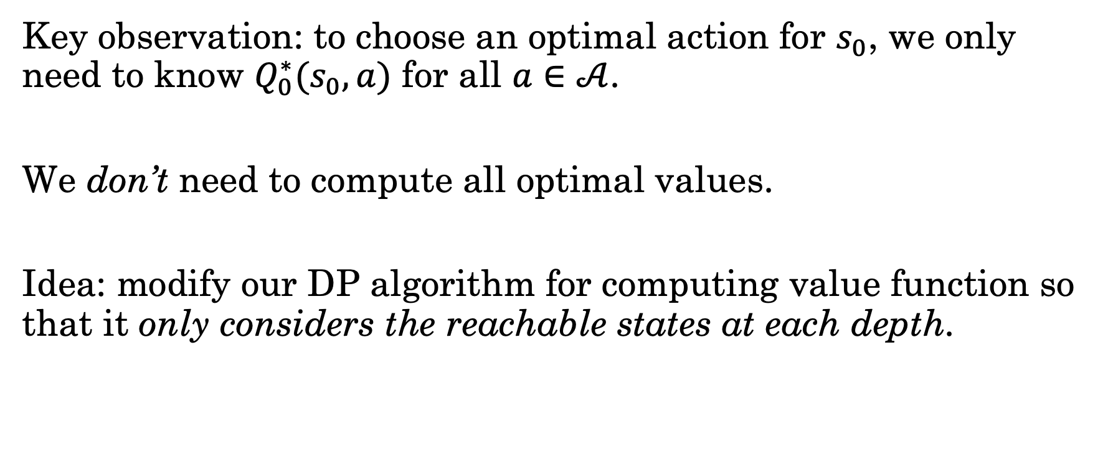
Using Reachable States: Finite Depth
Key observation: to choose an optimal action for $s_{0}$, we only need to know $Q_{0}^{∗}(s_{0}, a)$ for all $a∈𝒜$.
We don’t need to compute all optimal values.
Idea: modify our DP algorithm for computing value function so that it only considers the reachable states at each depth.

Slide 21
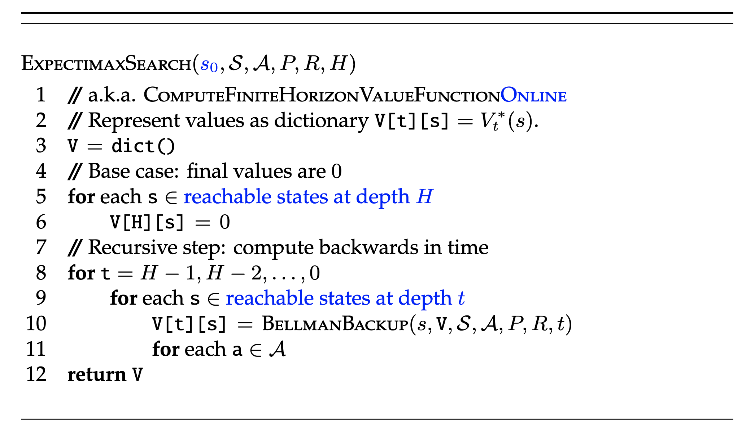
Using Reachable States: Finite Depth
a.k.a. expectimax search, forward search
Warning: don’t use this implementation. (See later slides)

Slide 22
Expectimax Search on AODAGs
Key ideas:
Start at the leaves, work up to the root
Annotate states with value function
Annotate actions with Q function

Slide 23


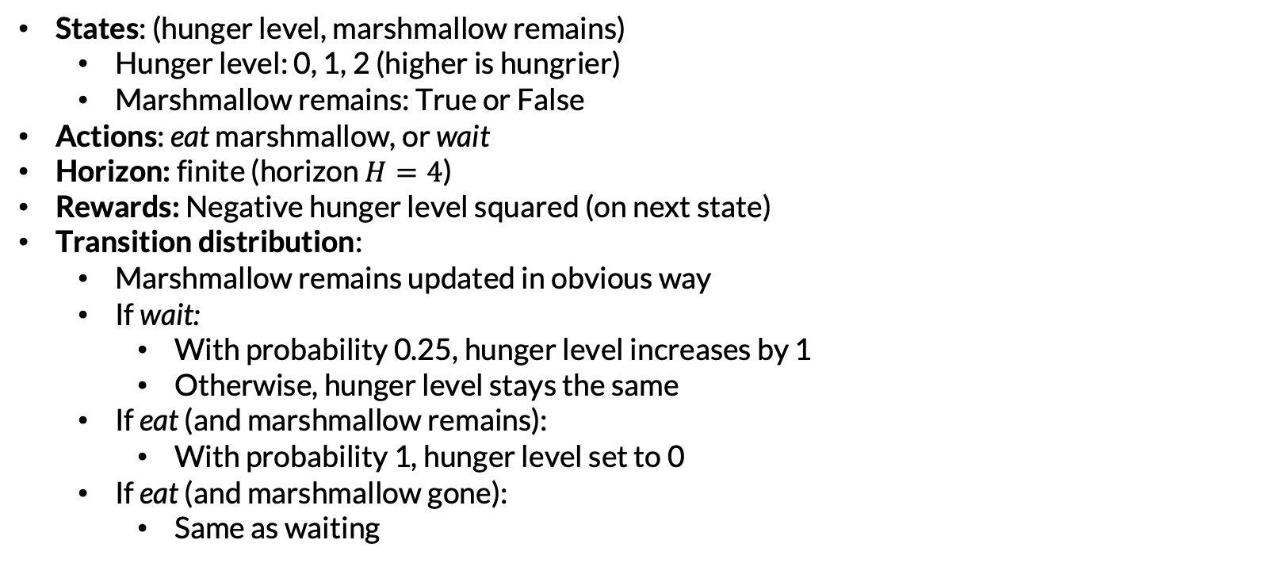
Example: Marshmallows
States: (hunger level, marshmallow remains)
Hunger level: 0, 1, 2 (higher is hungrier)
Marshmallow remains: True or False
Actions: eat marshmallow, or wait
Horizon: finite (horizon $H=4$)
Rewards: Negative hunger level squared (on next state)
Transition distribution:
Marshmallow remains updated in obvious way
If wait:
With probability 0.25, hunger level increases by 1
Otherwise, hunger level stays the same
If eat (and marshmallow remains):
With probability 1, hunger level set to 0
If eat (and marshmallow gone):
Same as waiting

Slide 24
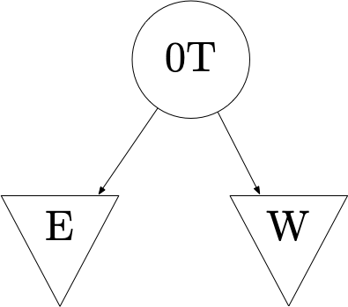

Slide 25
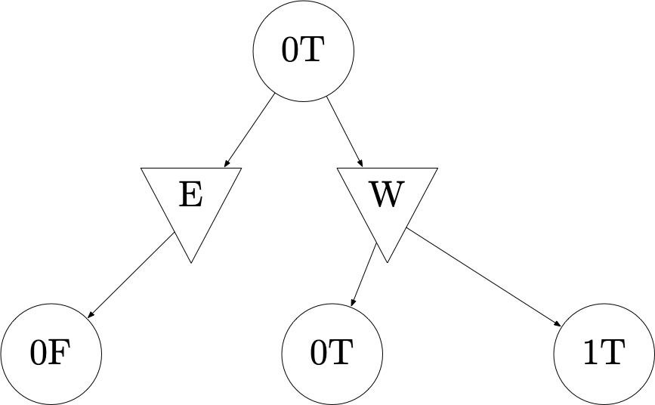

Slide 26
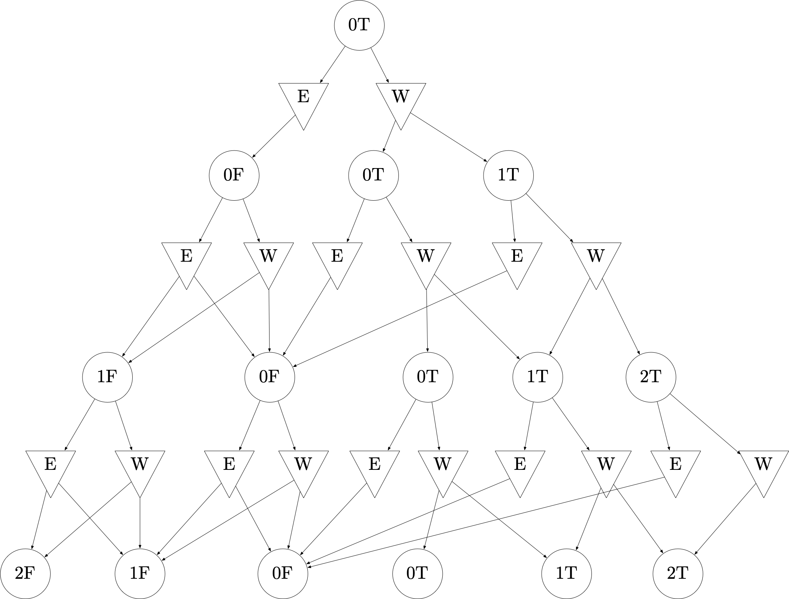

Slide 27
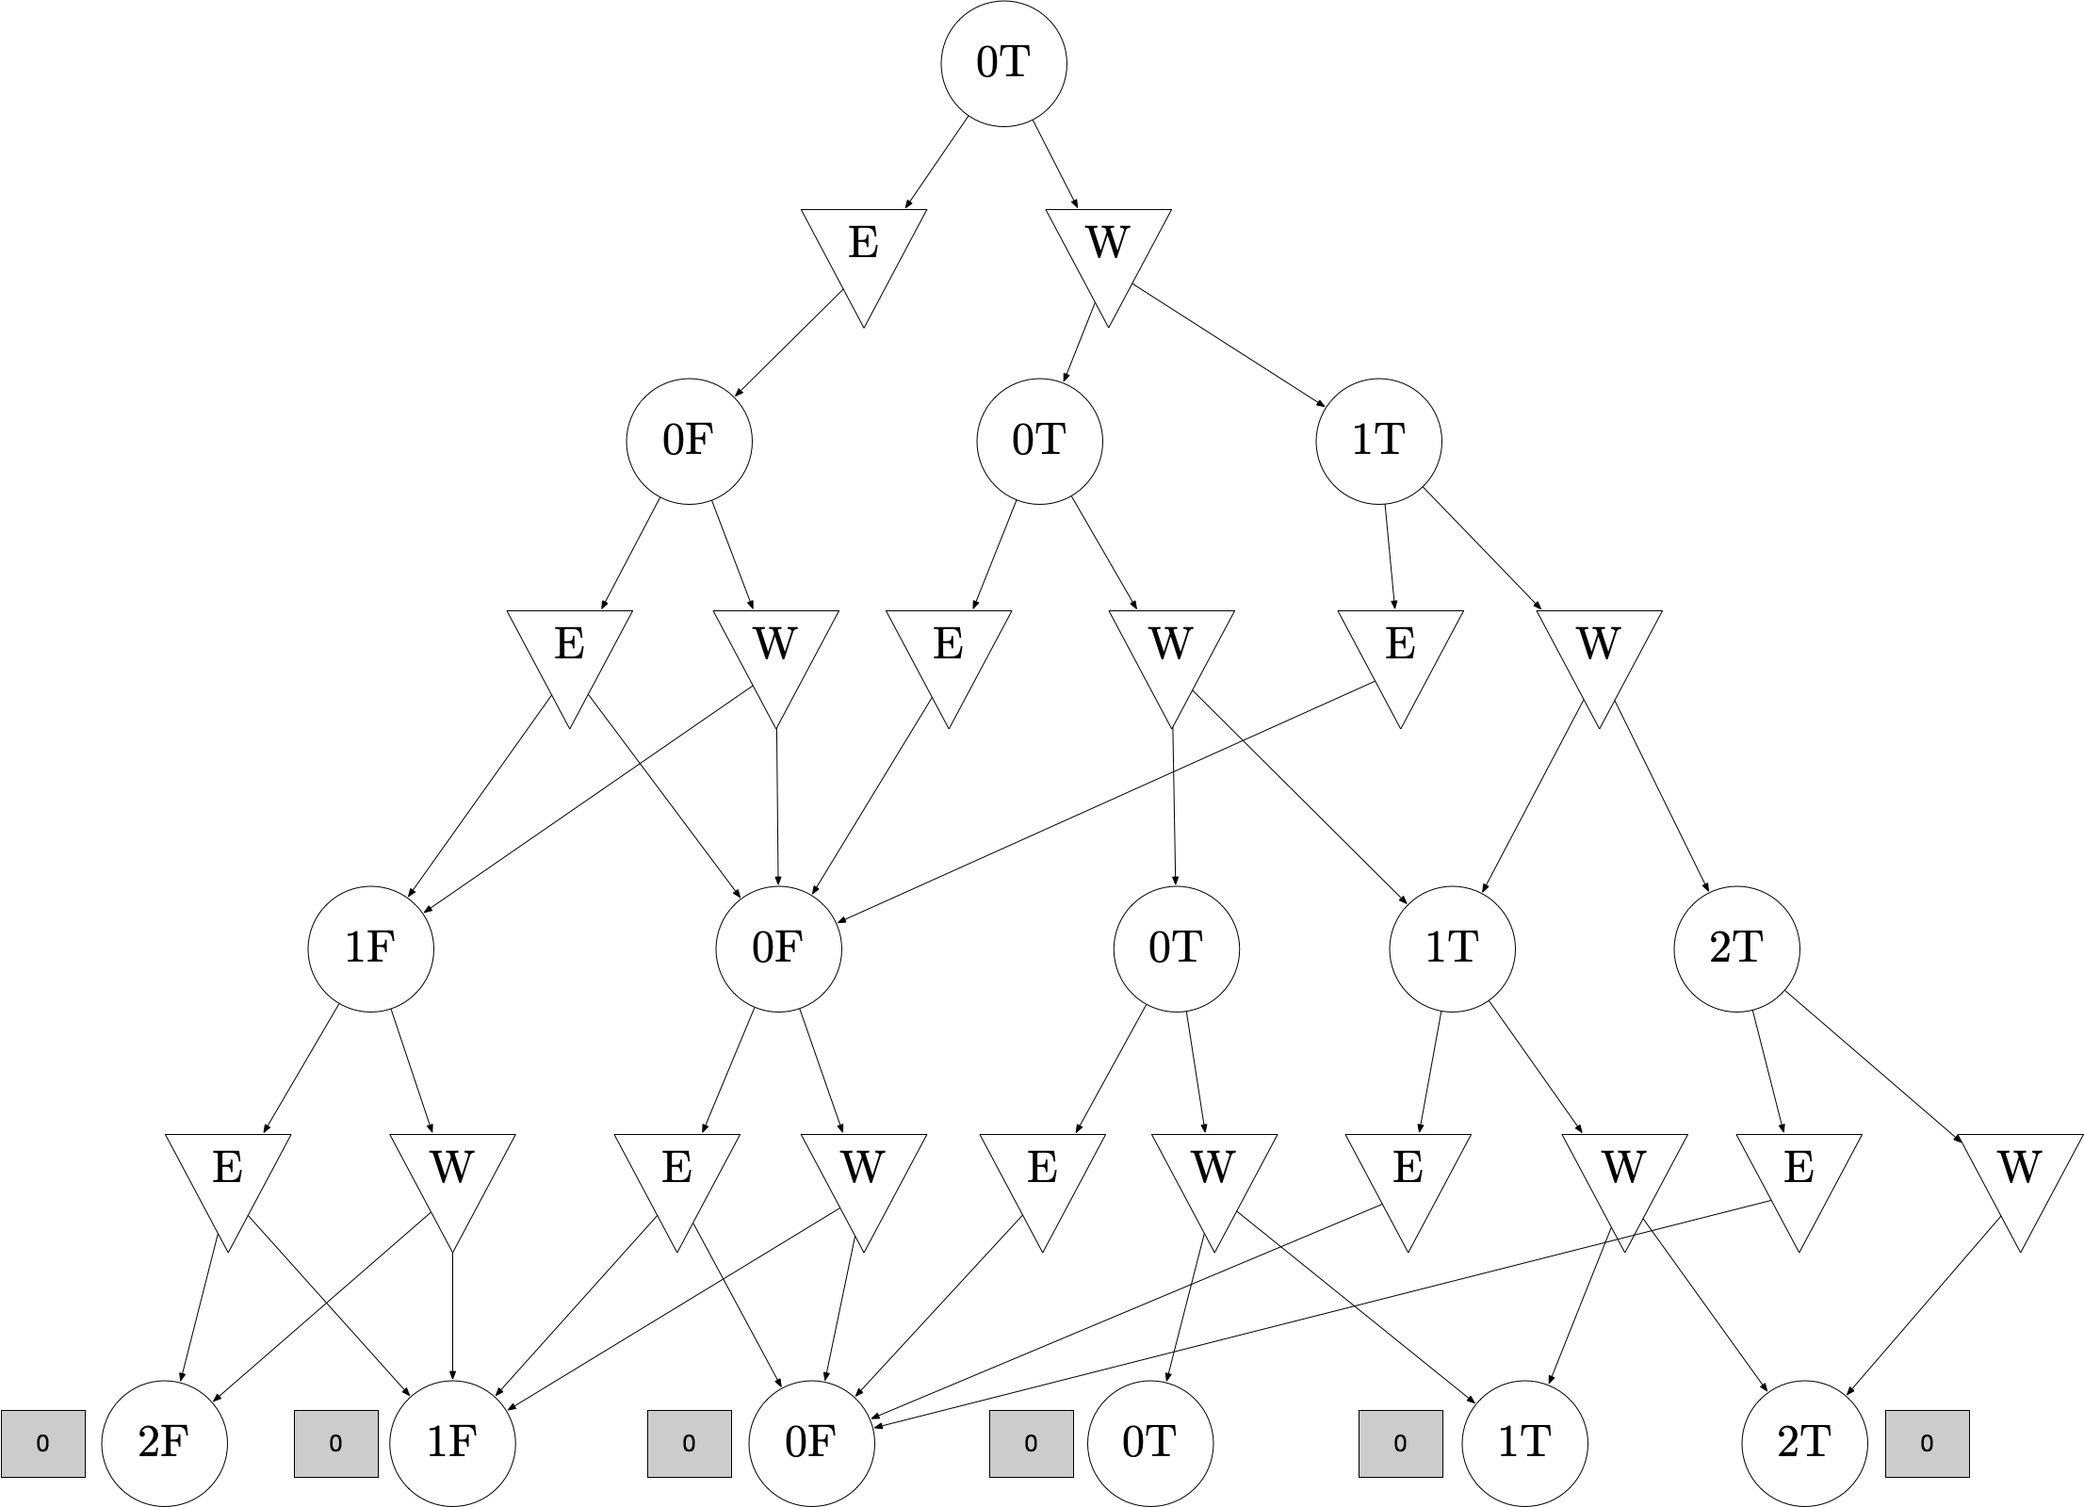

Slide 28
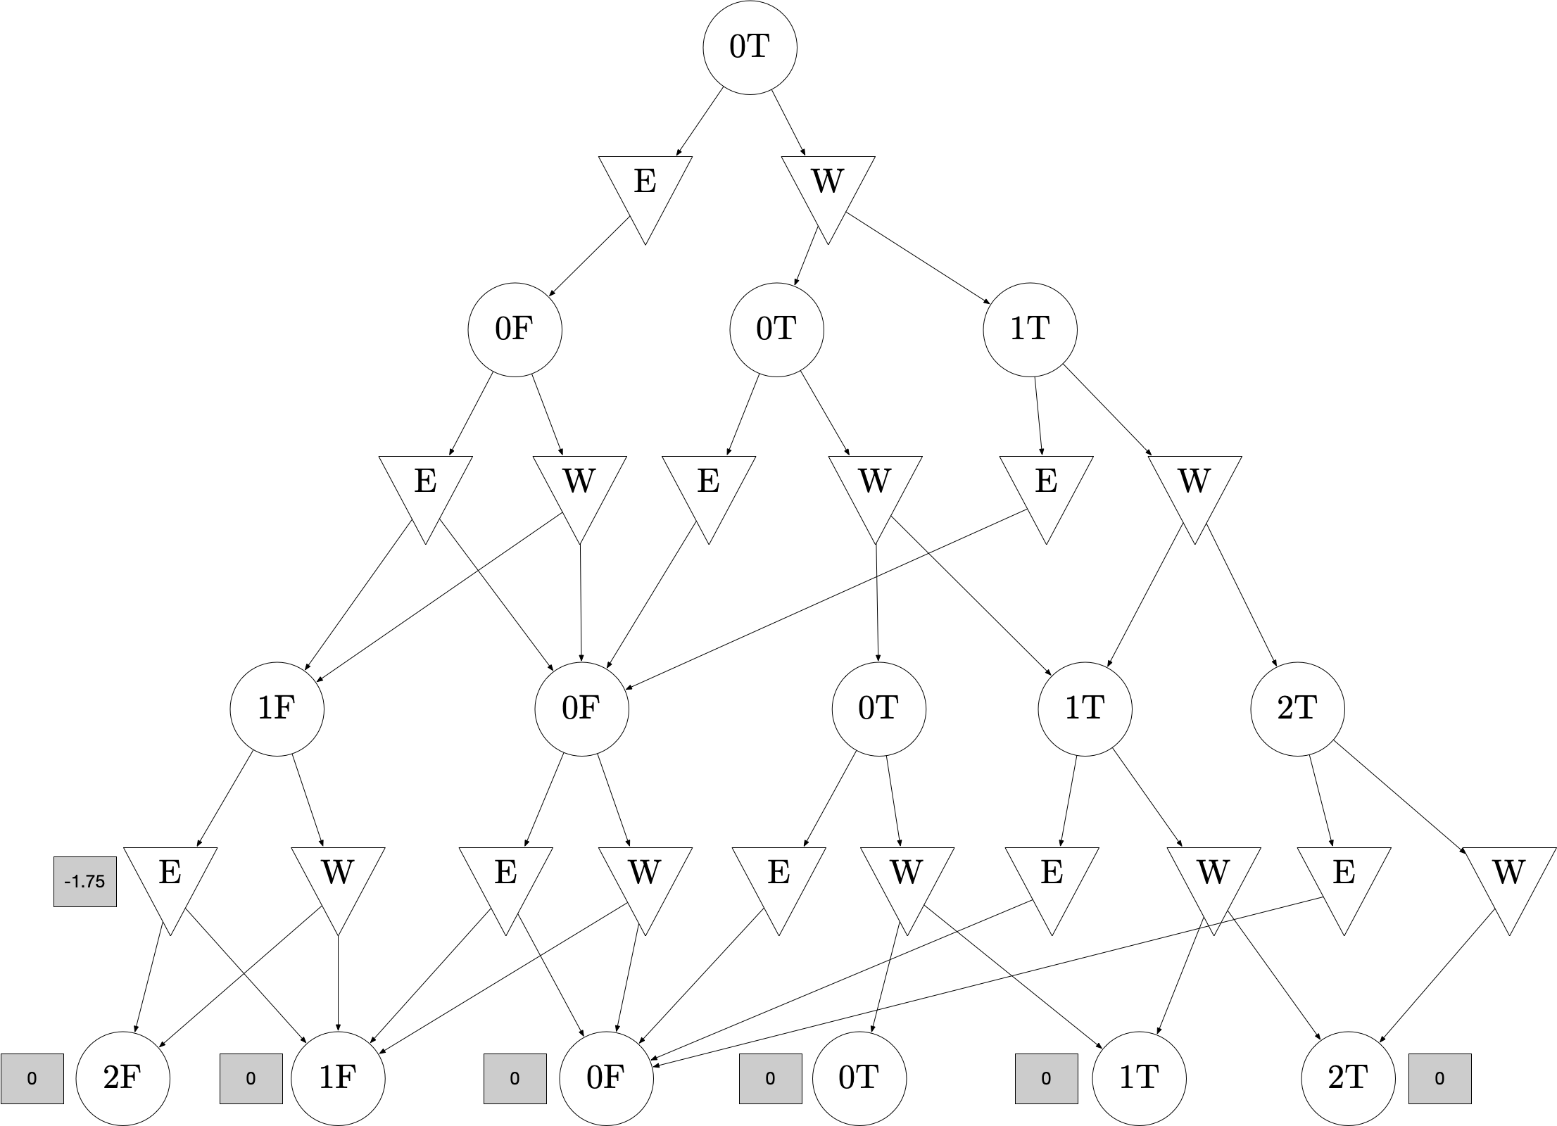
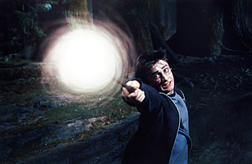
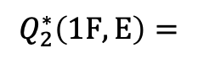
Expecti-!
$$Q_{2}^{∗}\left(1F, E\right)=$$
-4 * 0.25 + -1 * 0.75 = -1.75
2F
1F

Slide 29
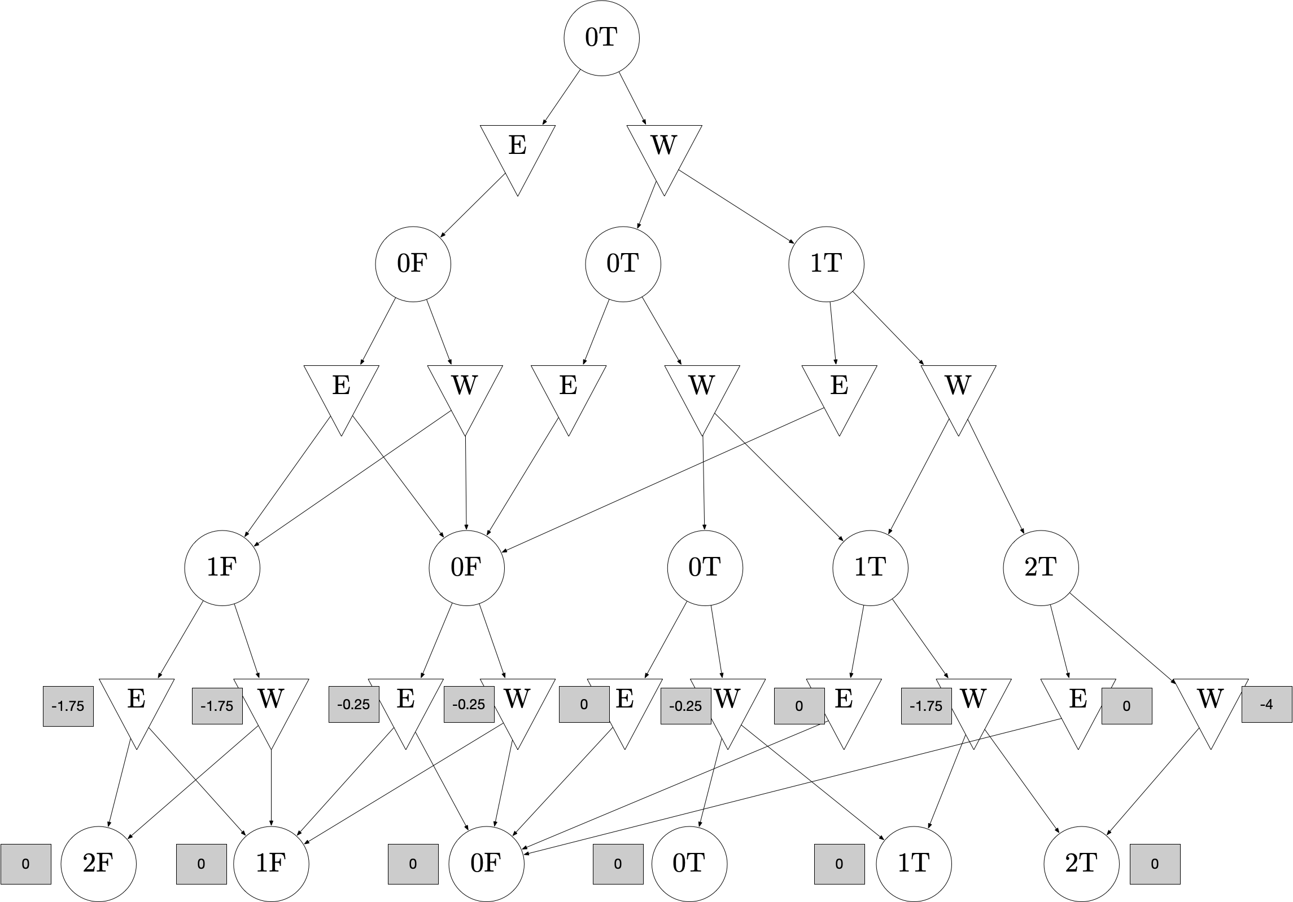
Expecti-!

Slide 30
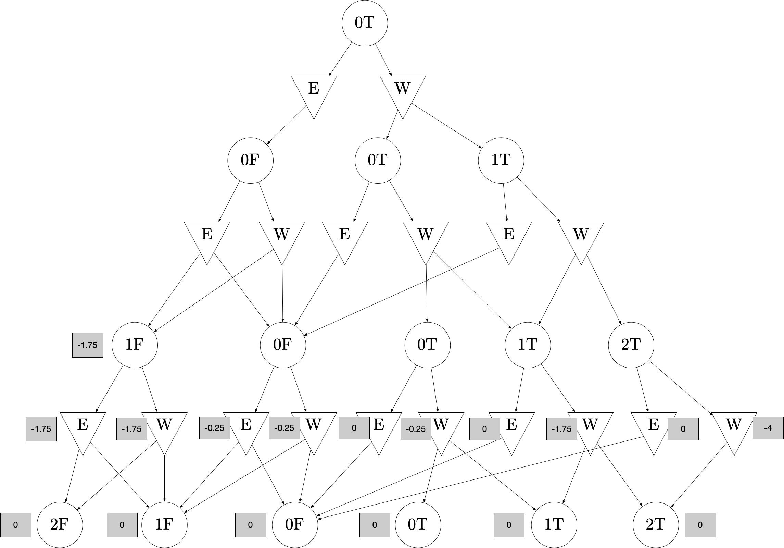
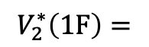
Max!
$$V_{2}^{∗}\left(1F\right)=$$
max(-1.75, -1.75) = -1.75
E
W

Slide 31
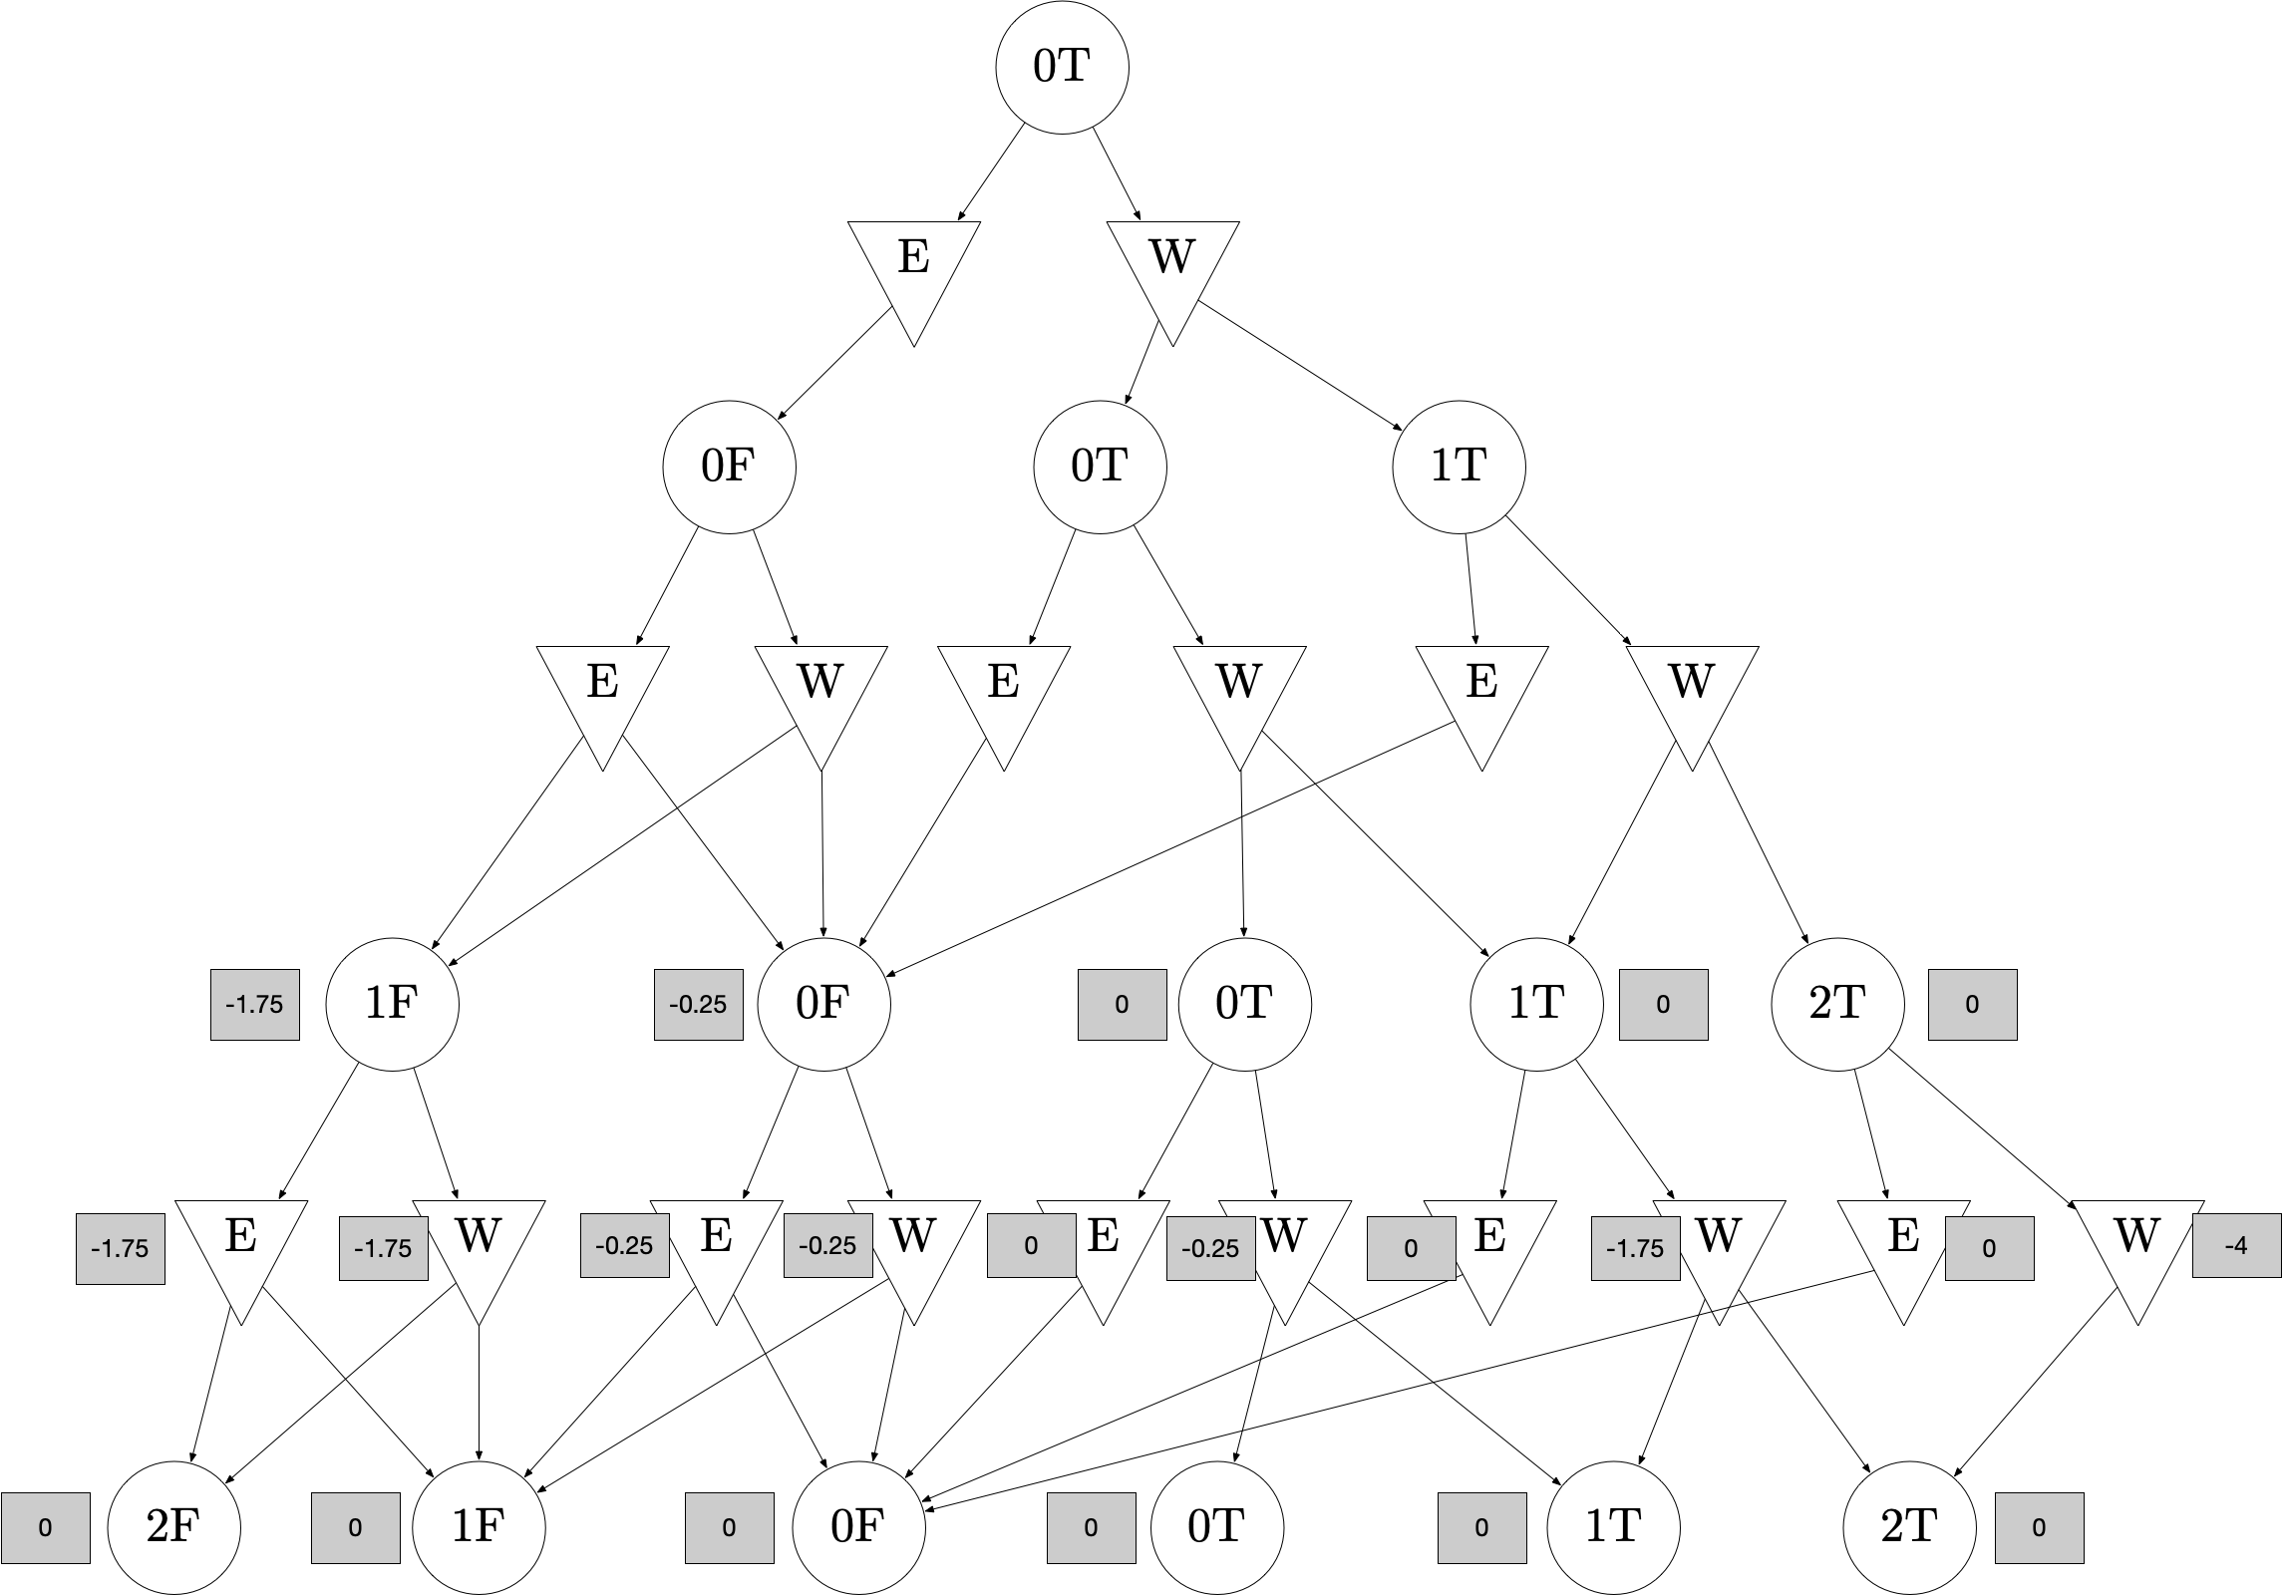
Max!

Slide 32
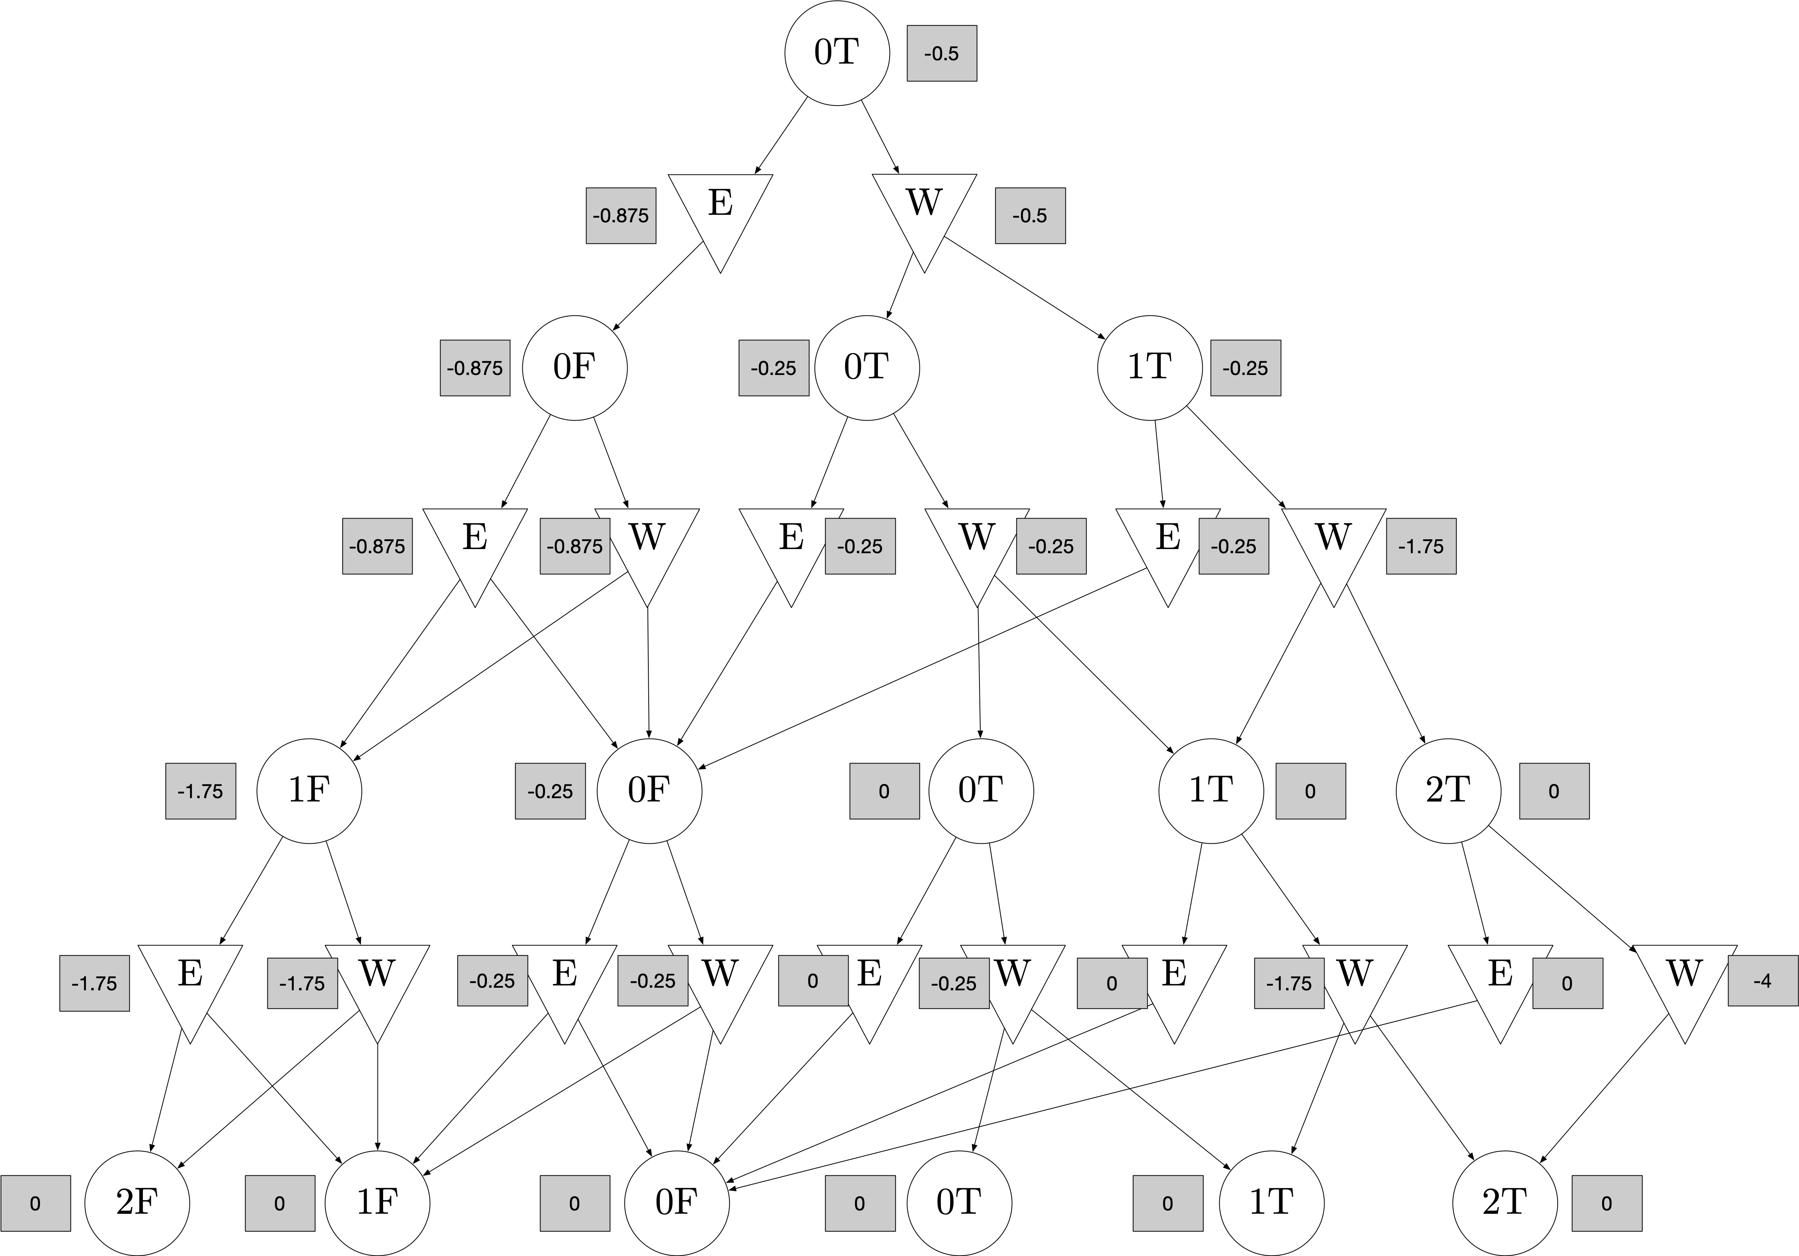

Slide 33
Interleaving Planning and Execution
In the wild, we can “plan a little”, “execute a little”, repeat.

Slide 34
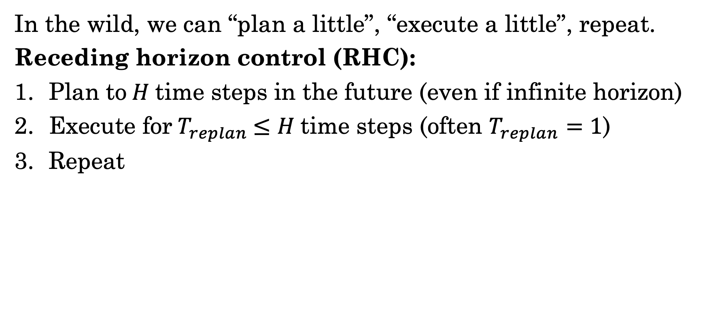
Interleaving Planning and Execution
In the wild, we can “plan a little”, “execute a little”, repeat.
Receding horizon control (RHC):
Plan to$H$time steps in the future (even if infinite horizon)
Execute for${ T}_{replan} ≤H$time steps (often $T_{replan}=1$)
Repeat

Slide 35
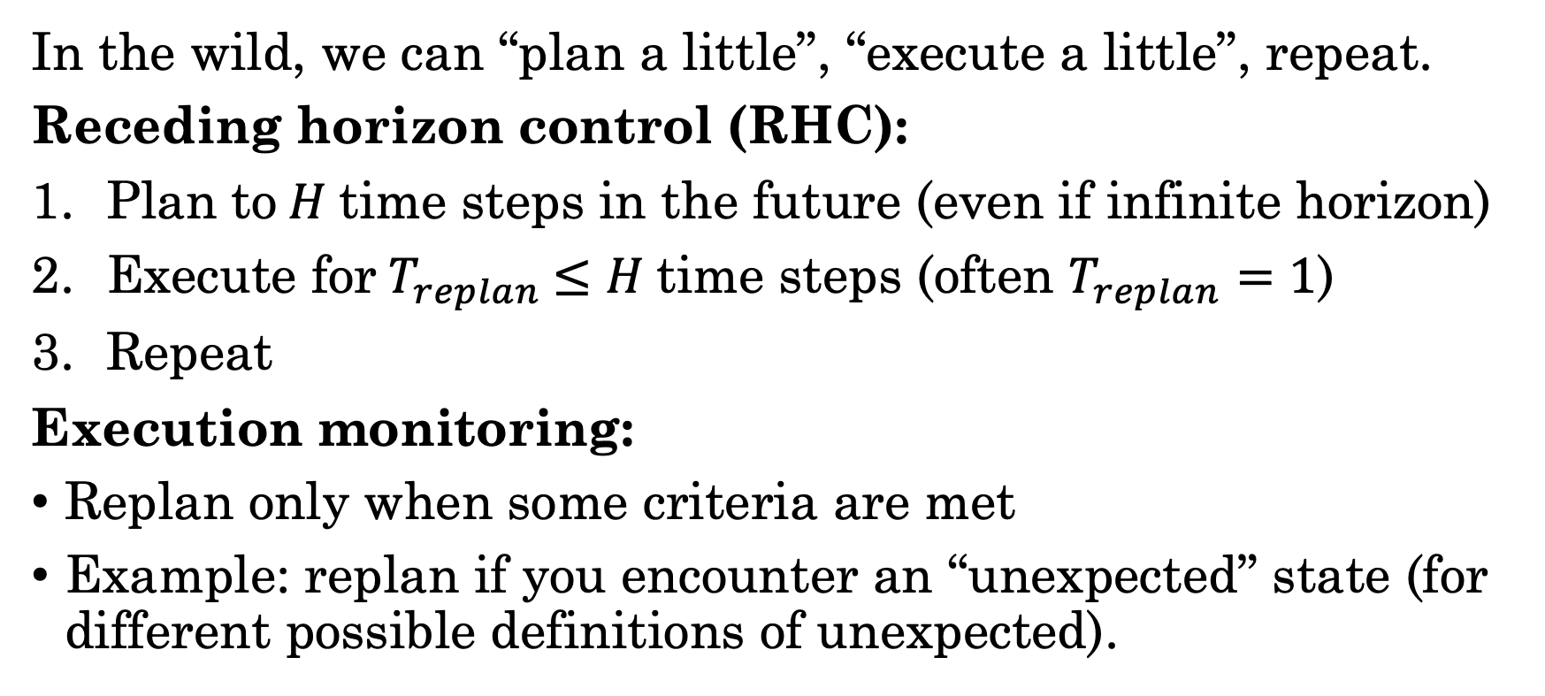
Interleaving Planning and Execution
In the wild, we can “plan a little”, “execute a little”, repeat.
Receding horizon control (RHC):
Plan to$H$time steps in the future (even if infinite horizon)
Execute for${ T}_{replan} ≤H$time steps (often $T_{replan}=1$)
Repeat
Execution monitoring:
Replan only when some criteria are met
Example: replan if you encounter an “unexpected” state (for different possible definitions of unexpected).

Slide 36
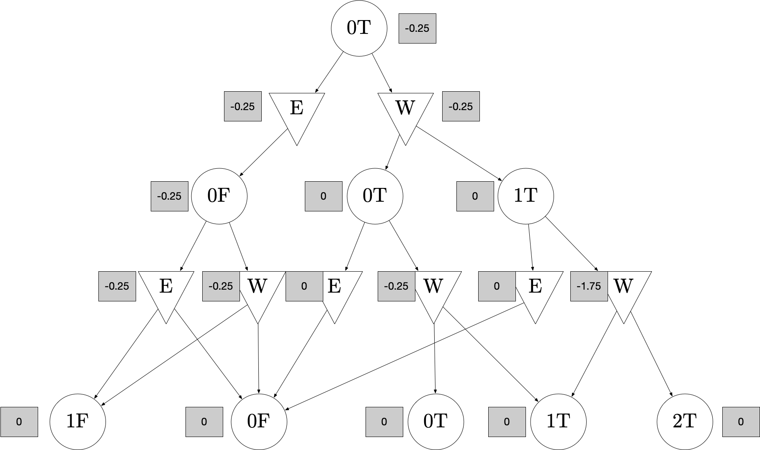
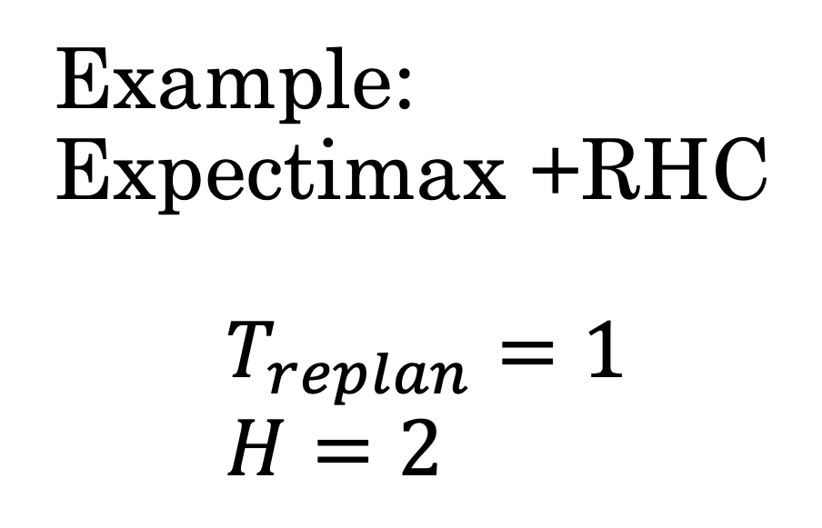
Example: Expectimax +RHC $$T_{replan}=1 \\ H=2$$
Timestep 0

Slide 37
Example: Expectimax +RHC $$T_{replan}=1 \\ H=2$$
Timestep 0
Random tiebreak: W

Slide 38
Example: Expectimax +RHC $$T_{replan}=1 \\ H=2$$
Timestep 1
Execution! Environment updates

Slide 39
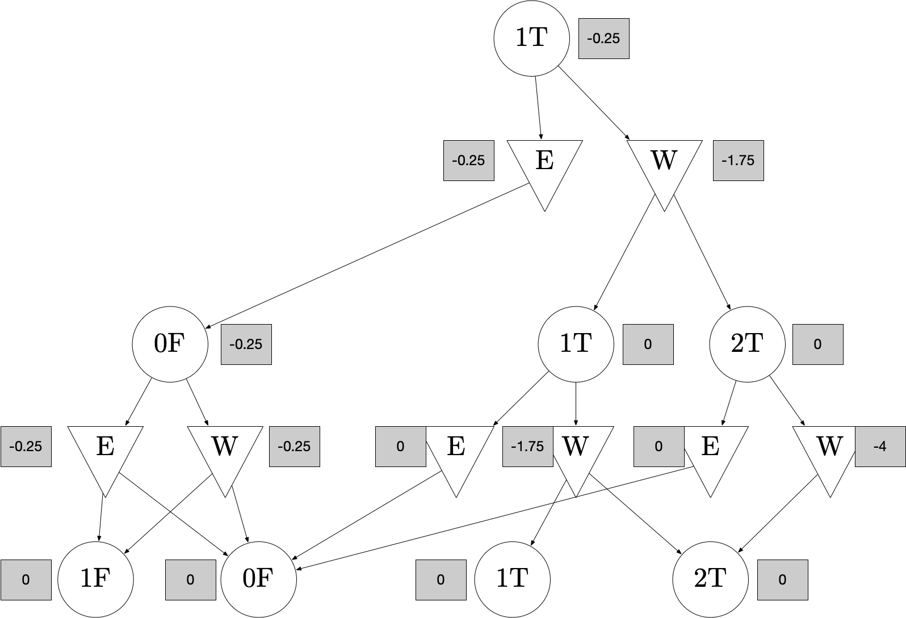
Example: Expectimax +RHC $$T_{replan}=1 \\ H=2$$
Timestep 1
Replanning

Slide 40
Example: Expectimax +RHC $$T_{replan}=1 \\ H=2$$
Timestep 1
Taking best action E

Slide 41
Example: Expectimax +RHC $$T_{replan}=1 \\ H=2$$
Timestep 2
Execution! Environment updates

Slide 42
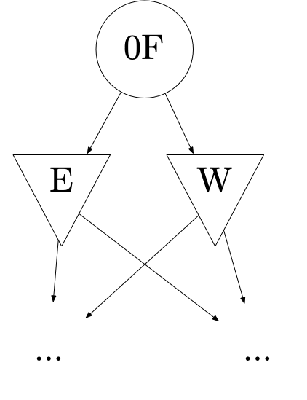
Example: Expectimax +RHC $$T_{replan}=1 \\ H=2$$
Timestep 2
Etc.

Slide 43
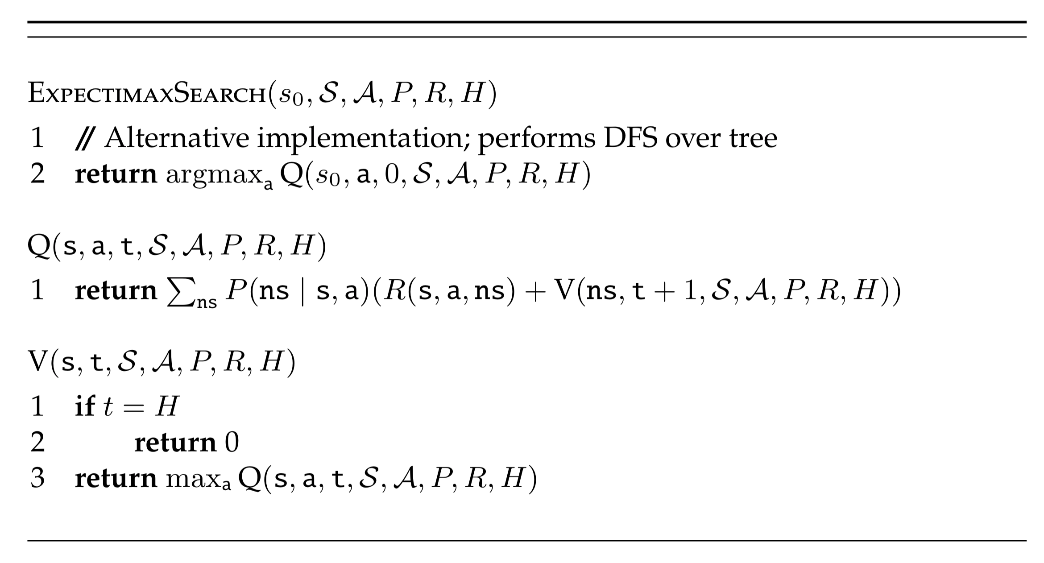
Expectimax Search: Alternative Implementation
Construct tree and compute values simultaneously.

Slide 44
Expectimax Search: Alternative Implementation
Construct tree and compute values simultaneously.
This is the more common implementation of expectimax that you should probably use!
Returns first action only. Assumes replanning
Note that without caching, this computes a tree, not AODAG. (Possible duplicates.)

Slide 45


Slide 46
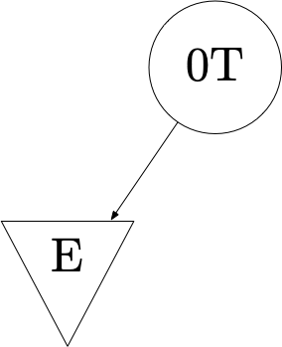

Slide 47
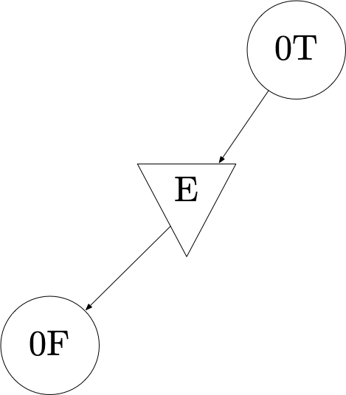

Slide 48
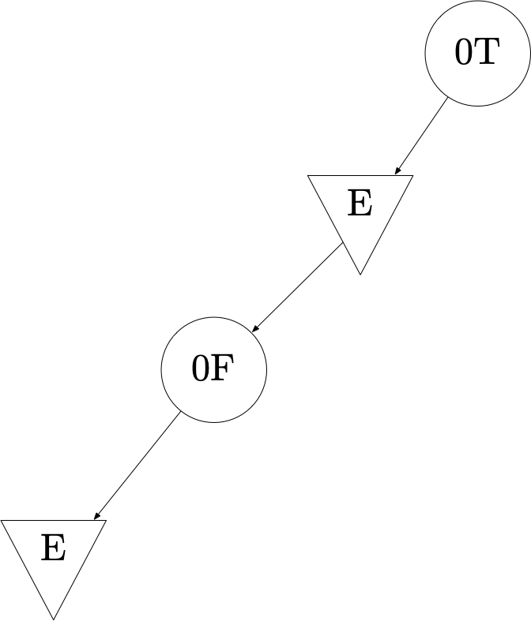

Slide 49
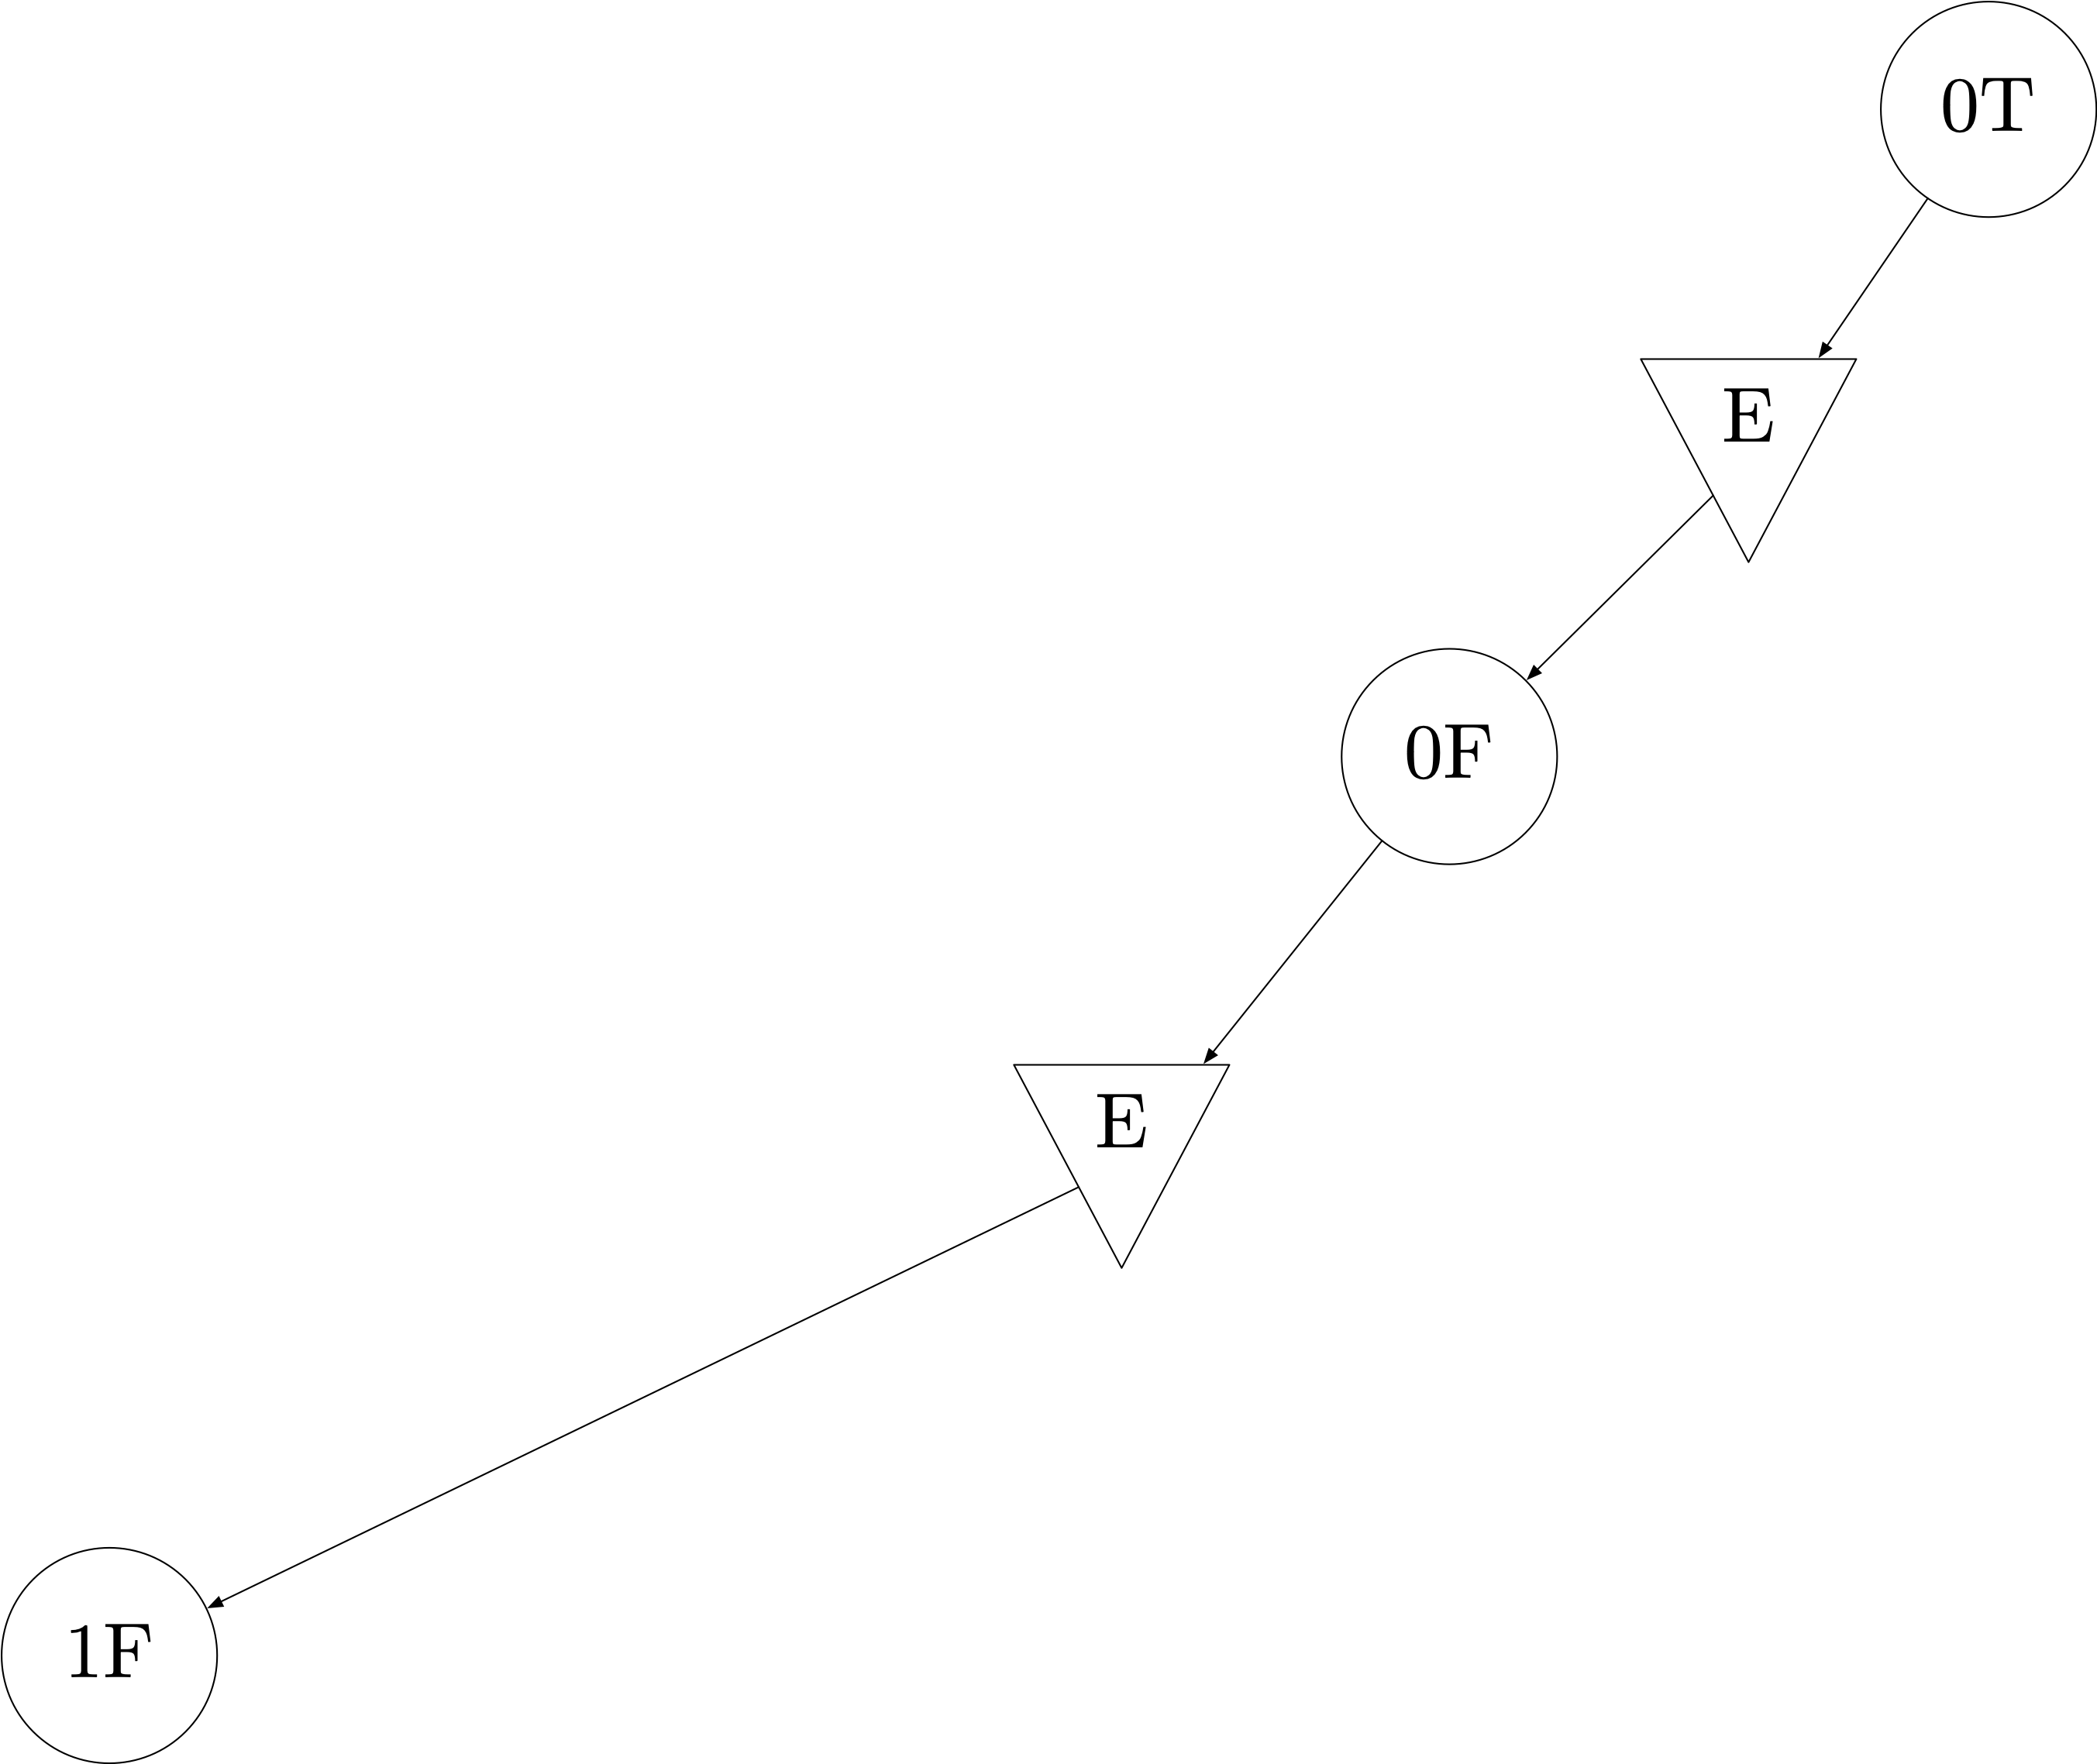

Slide 50
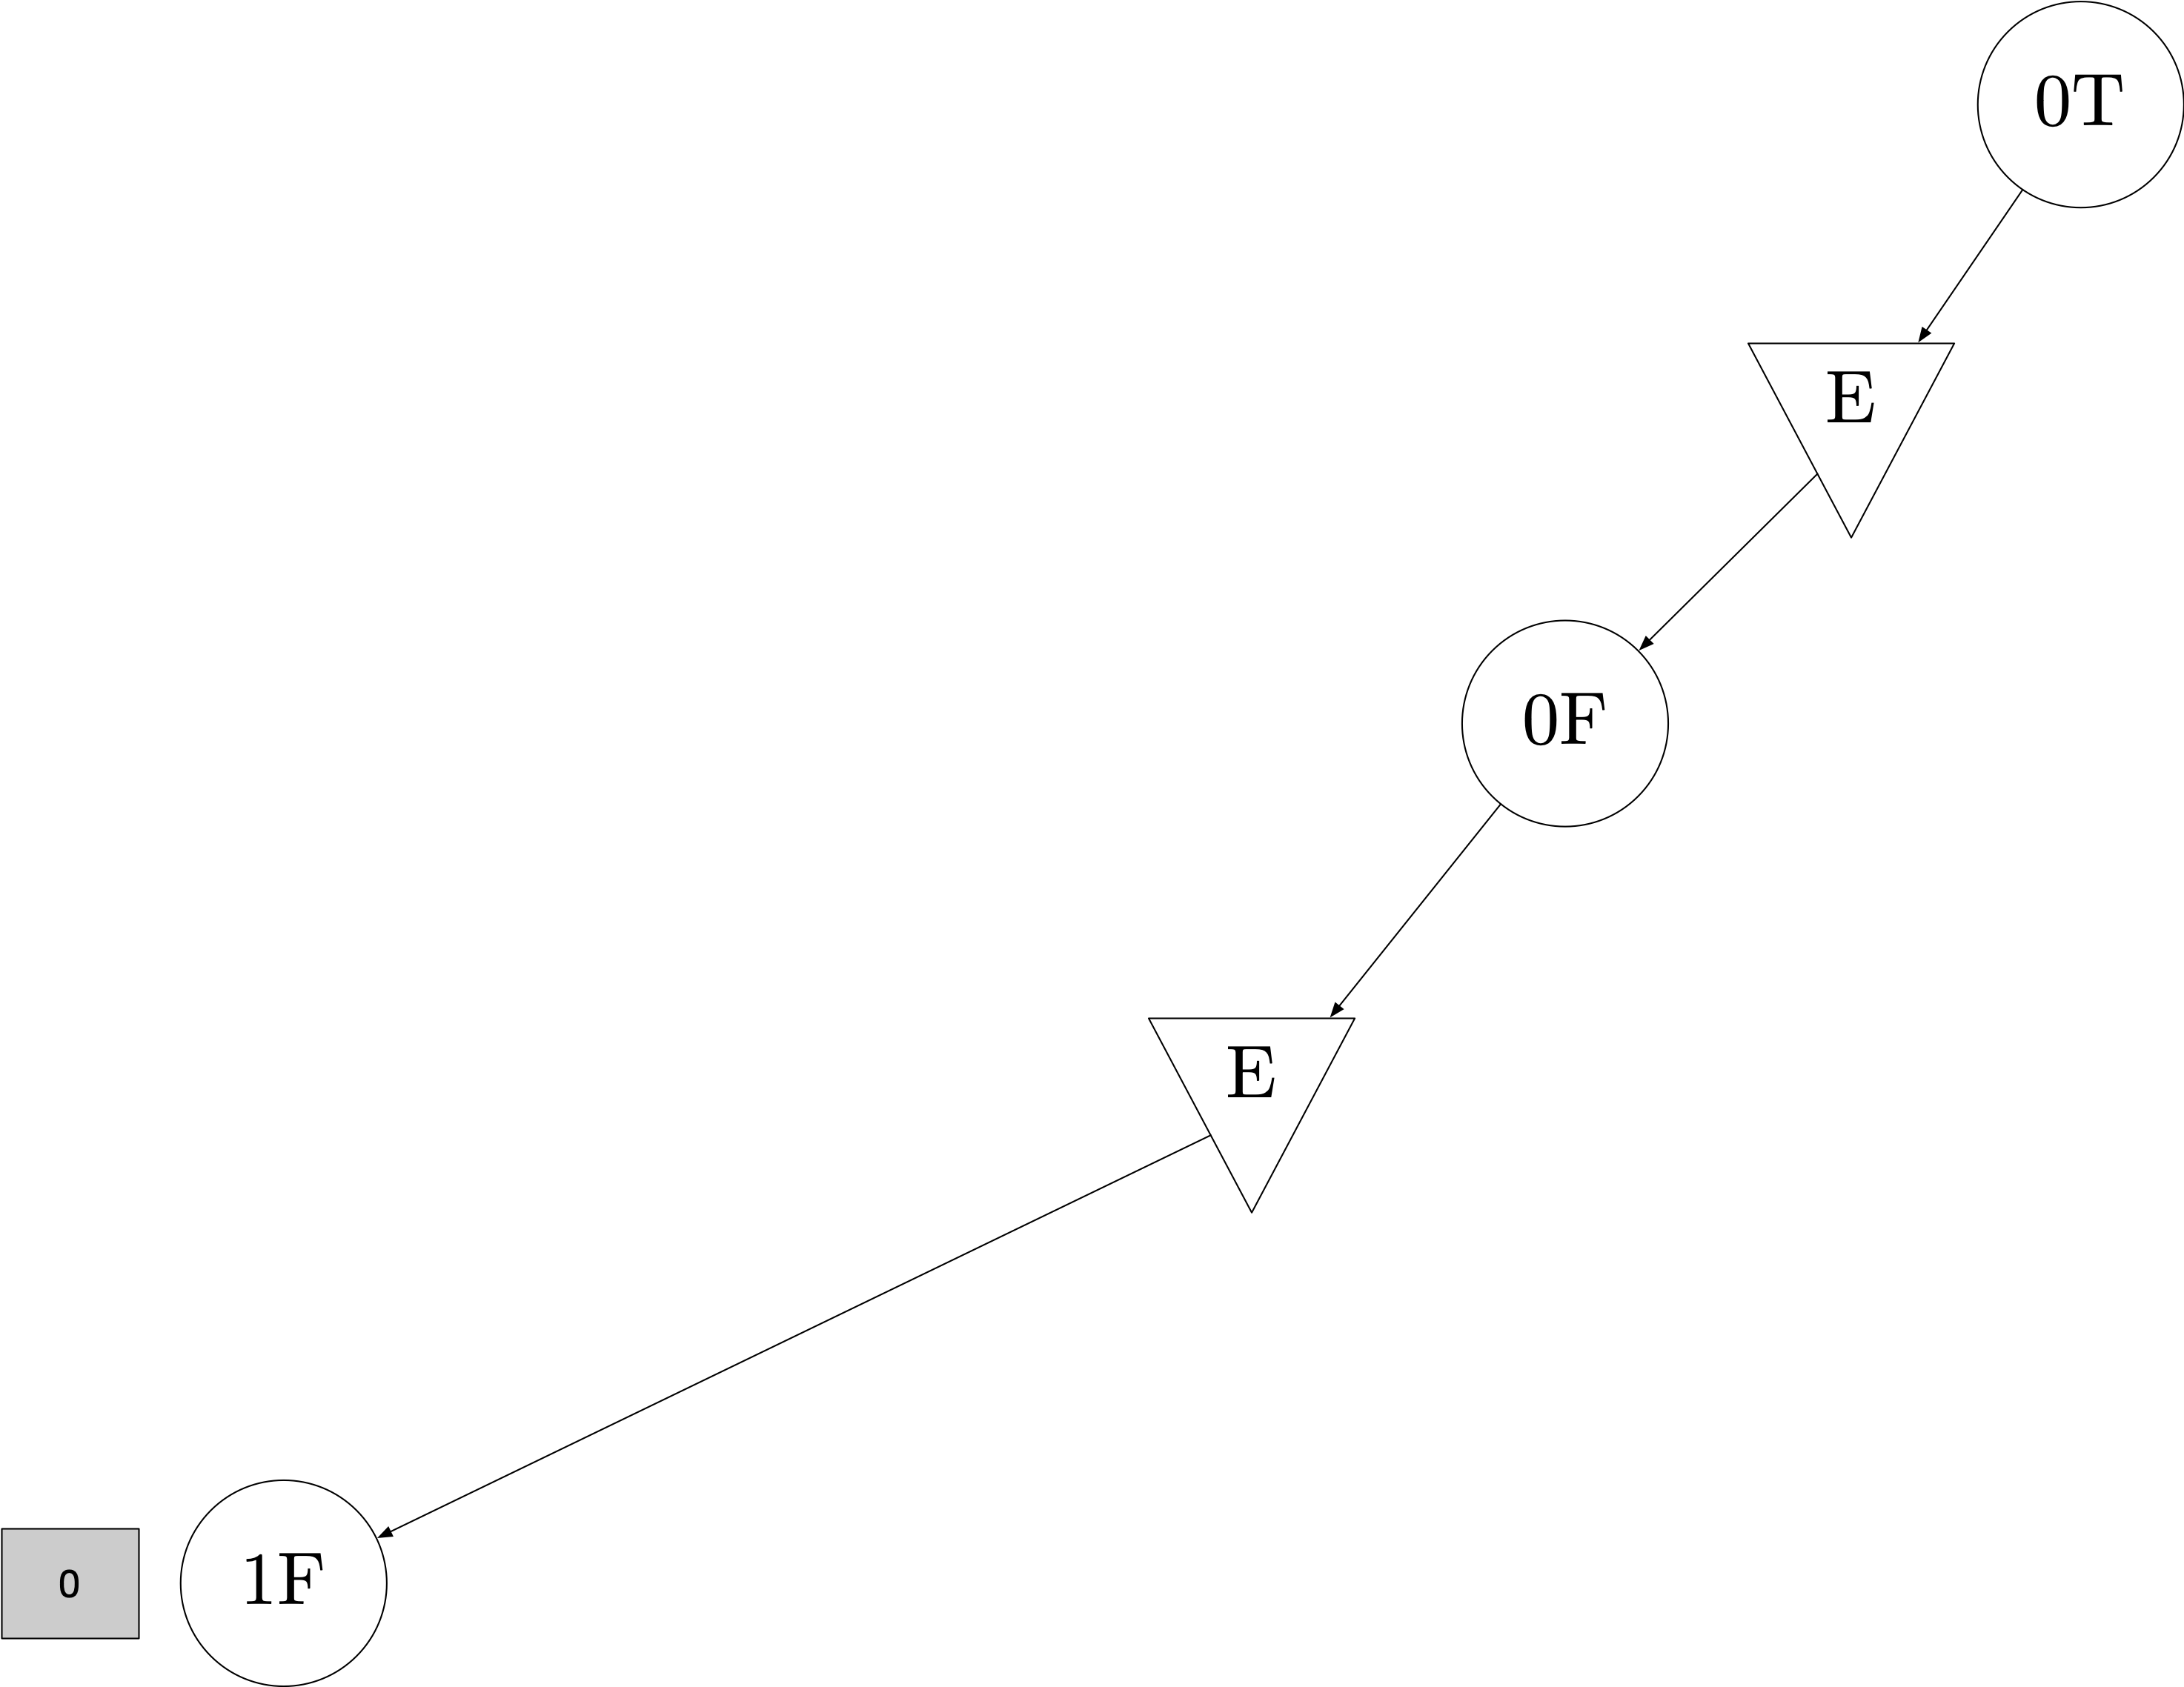

Slide 51
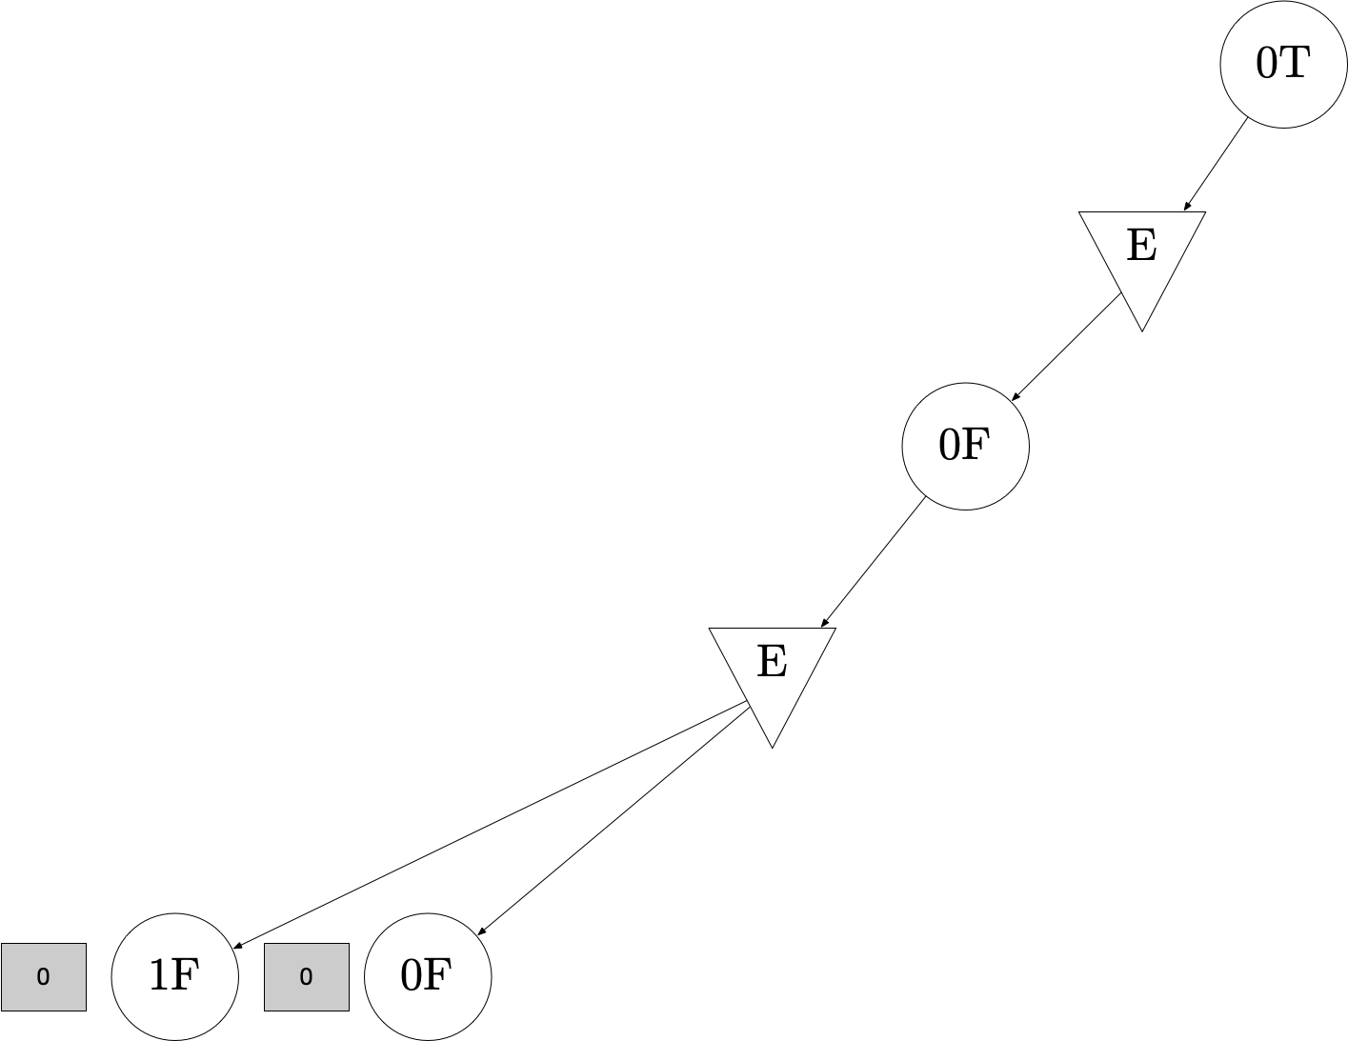

Slide 52
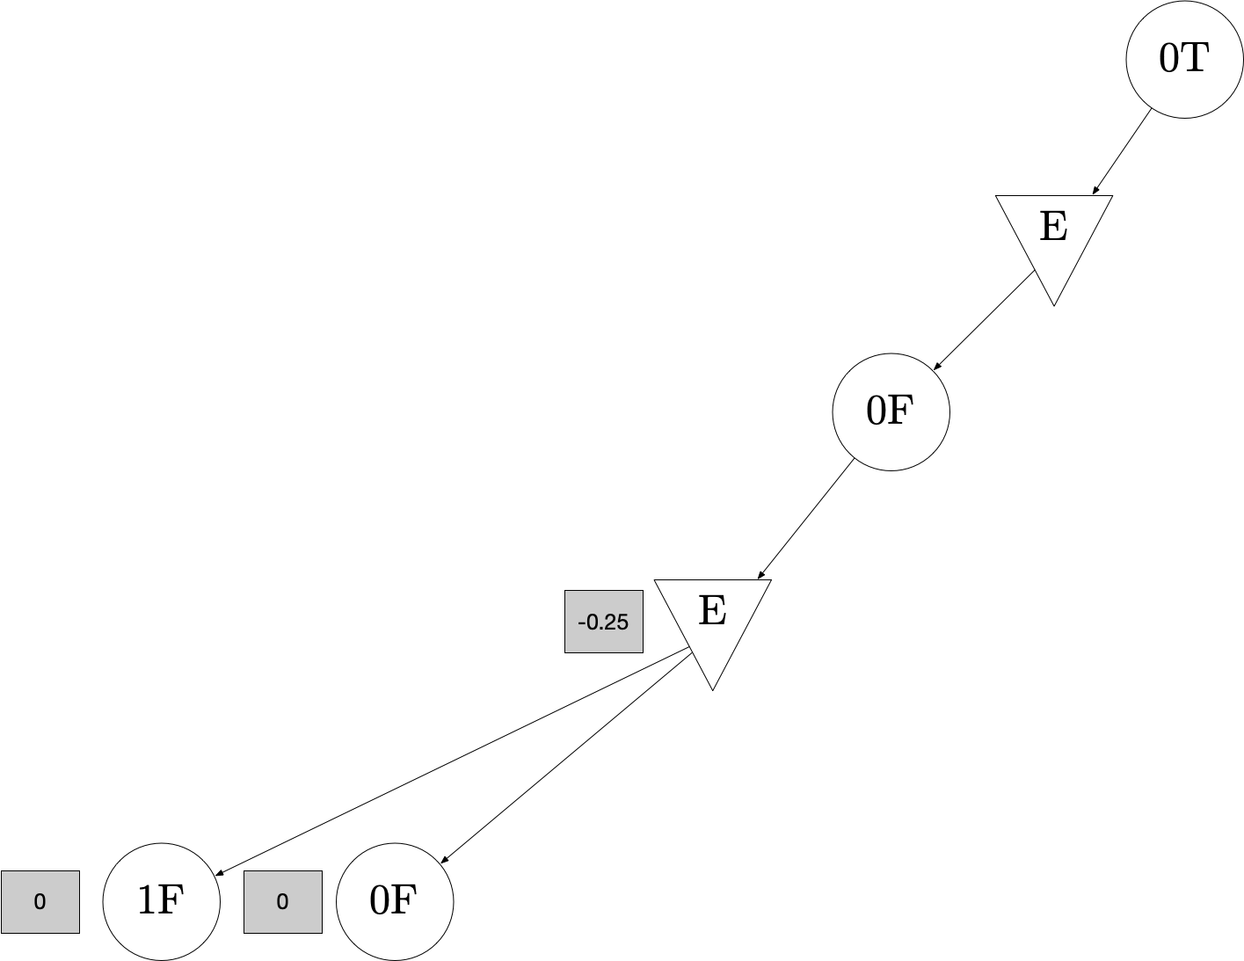

Slide 53


Slide 54
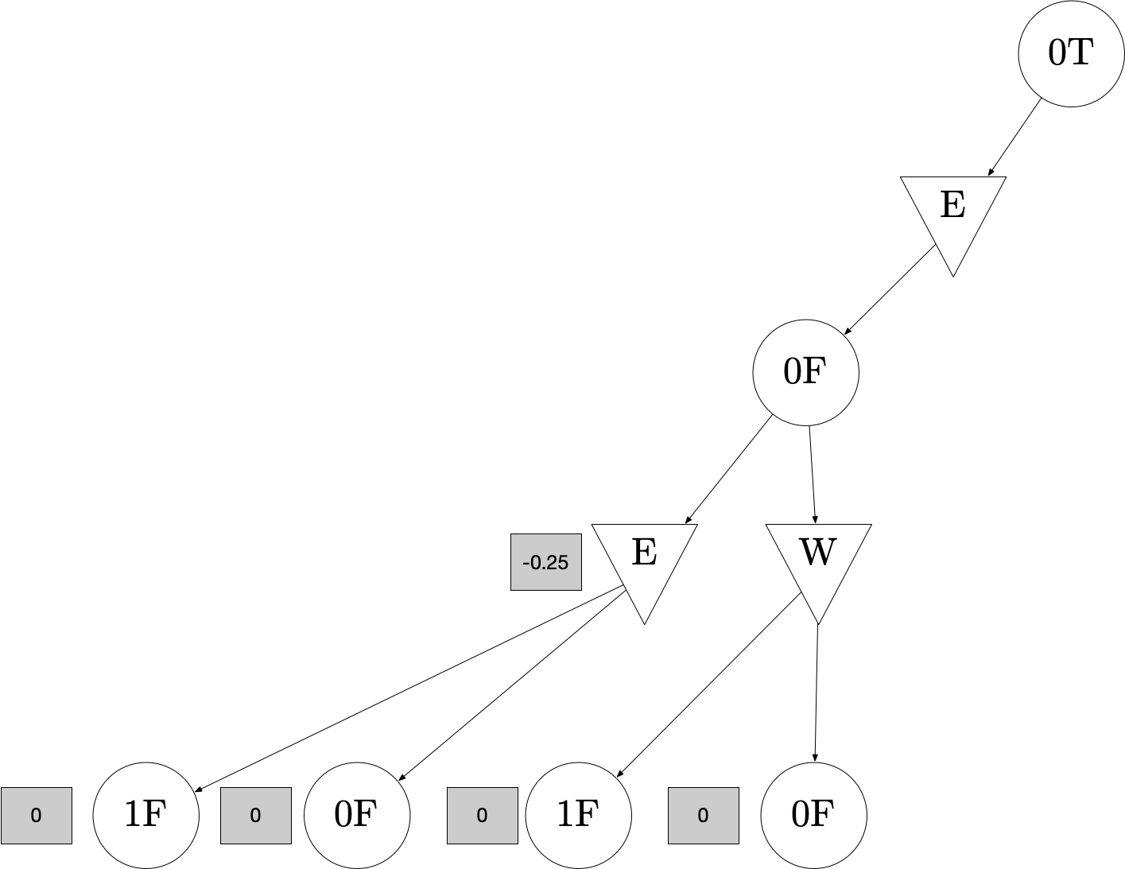

Slide 55
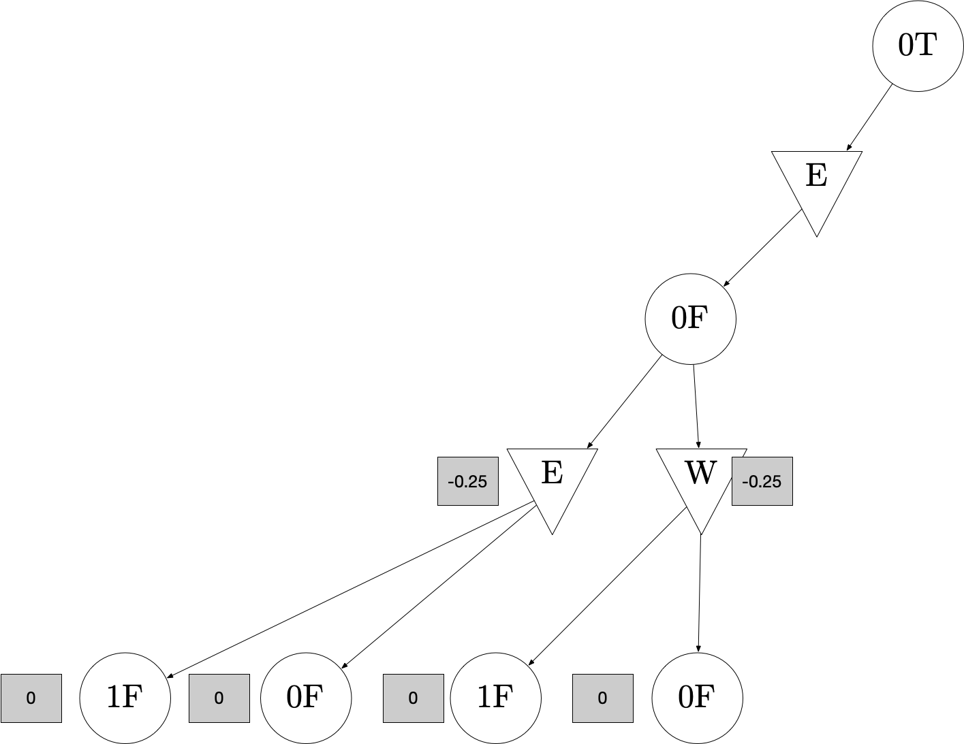

Slide 56
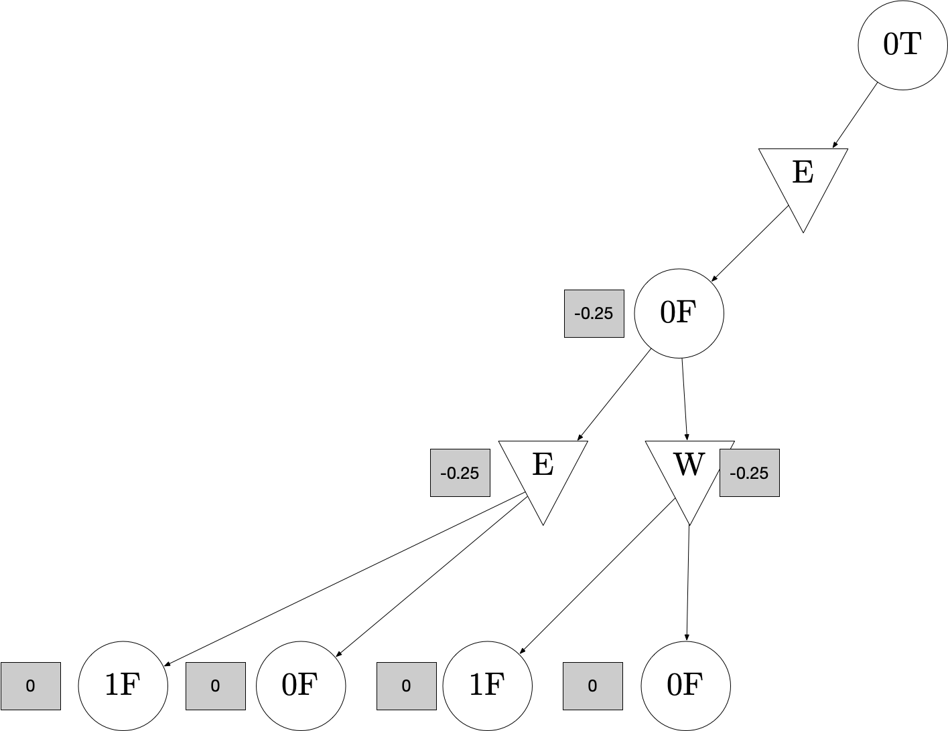

Slide 57
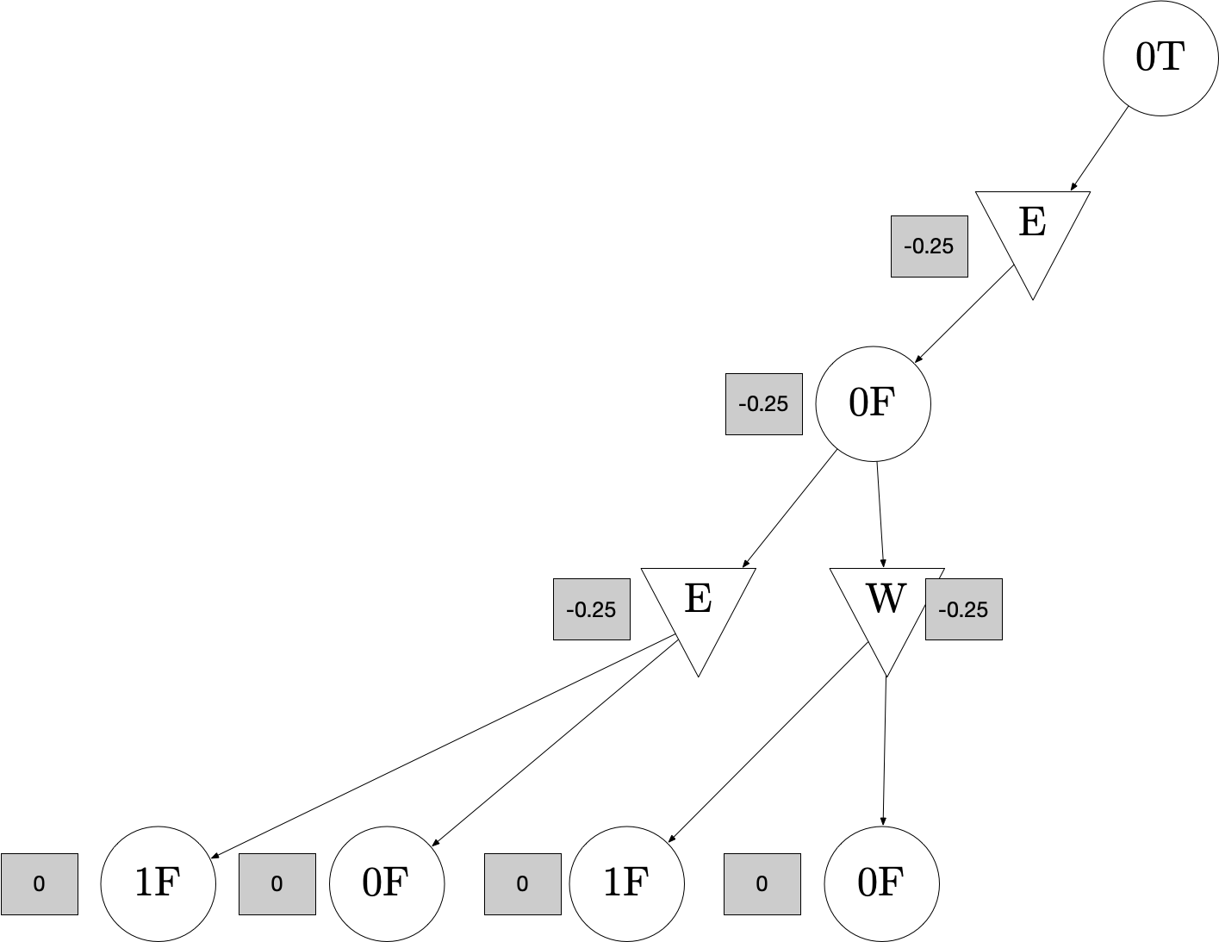

Slide 58
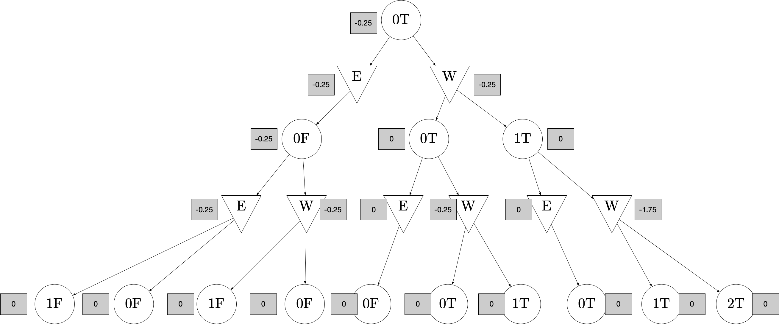

Slide 59
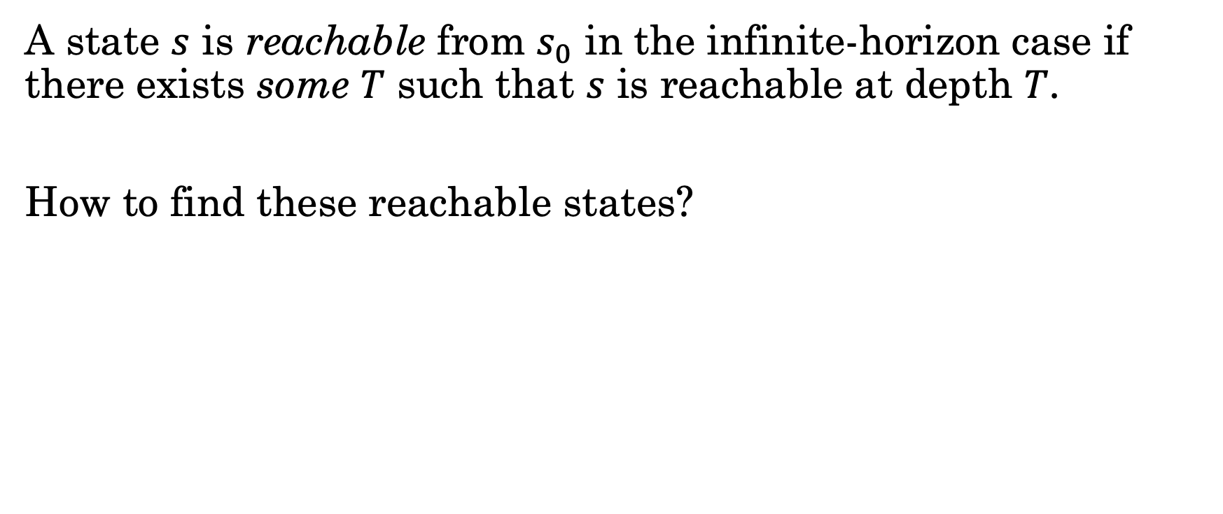
Finding Reachable States: Infinite Depth
A state $s$ is reachable from $s_{0}$ in the infinite-horizon case if there exists some $T$ such that $s$ is reachable at depth $T$.
How to find these reachable states?

Slide 60
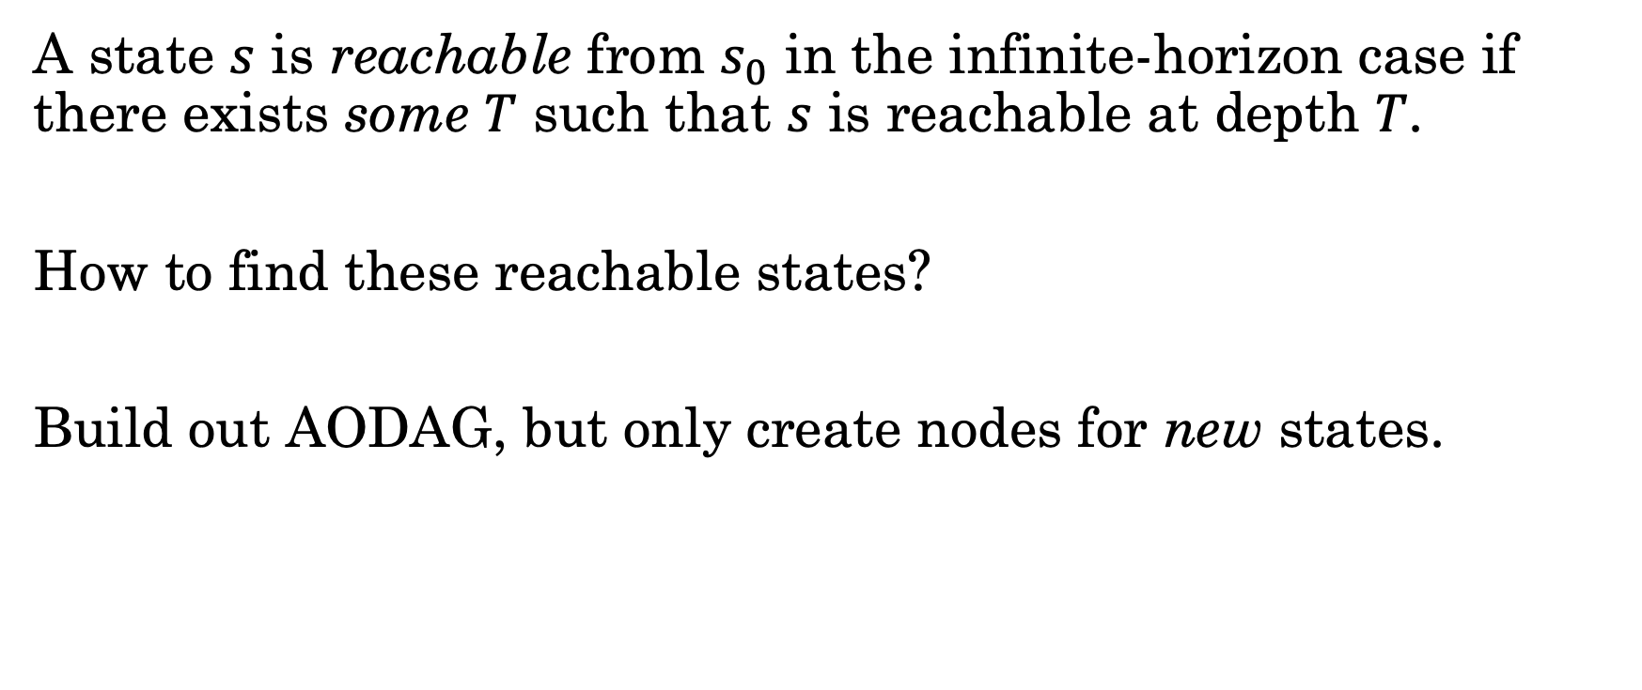
Finding Reachable States: Infinite Depth
A state $s$ is reachable from $s_{0}$ in the infinite-horizon case if there exists some $T$ such that $s$ is reachable at depth $T$.
How to find these reachable states?
Build out AODAG, but only create nodes for new states.

Slide 61
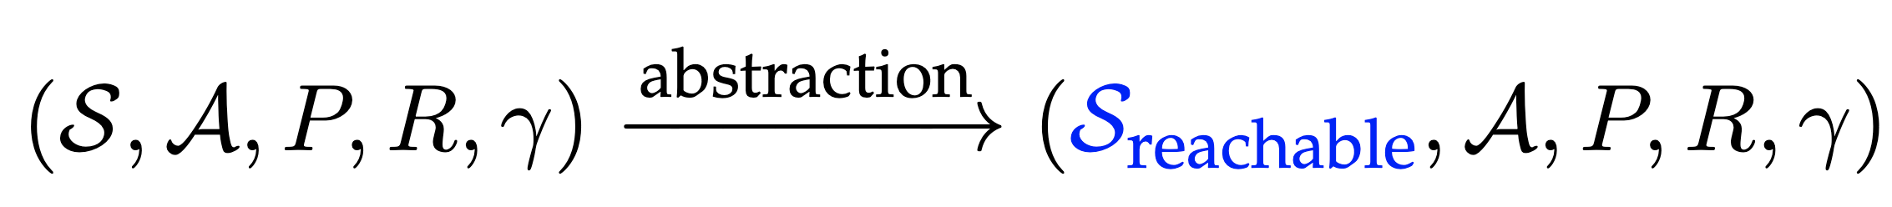
Using Reachable States: Infinite Depth
Idea: create an abstract MDP with only the reachable states.
Then, plan in the abstract MDP.

Slide 62
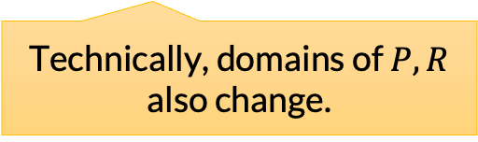
Using Reachable States: Infinite Depth
Idea: create an abstract MDP with only the reachable states.
Then, plan in the abstract MDP.
Technically, domains of $P, R$ also change.
This is a simple MDP abstraction. Others exist; active research area.

Slide 63
When is Reachability Not Enough?
Sometimes, the number of reachable states is just too large

Slide 64
When is Reachability Not Enough?
Sometimes, the number of reachable states is just too large
Receding horizon control may also fail
If all rewards within short horizons are trivial
Or if the rewards seen within short horizons are misleading

Slide 65
When is Reachability Not Enough?
Sometimes, the number of reachable states is just too large
Receding horizon control may also fail
If all rewards within short horizons are trivial
Or if the rewards seen within short horizons are misleading
Heuristics to the rescue!

Slide 66
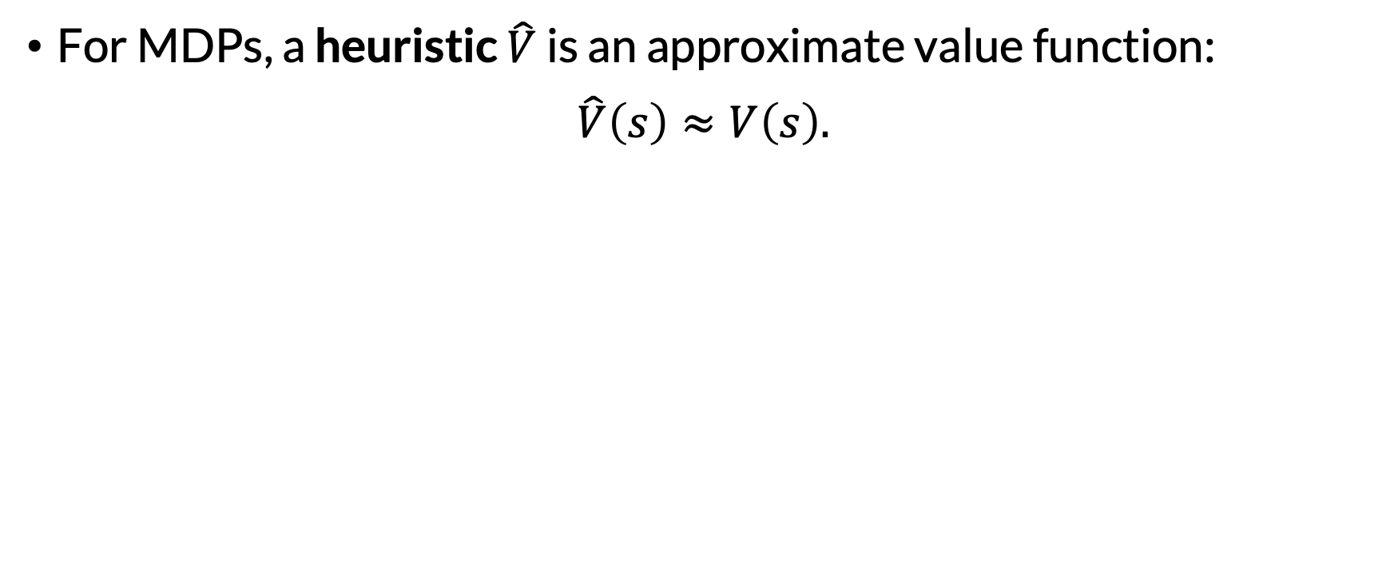
Heuristics for MDPs
For MDPs, a heuristic $\hat{V}$ is an approximate value function:
$$\hat{V}\left(s\right)≈V\left(s\right).$$

Slide 67

Heuristics for MDPs
For MDPs, a heuristic $\hat{V}$ is an approximate value function:
$$\hat{V}\left(s\right)≈V\left(s\right).$$
A heuristic is admissible if $∀s∈𝒮.\hat{V}\left(s\right)≥V\left(s\right)$
Can also weaken this to “for all reachable states”

Slide 68

Expectimax + Heuristic Leaf Evals
Idea: do receding horizon control, with expectimax search.
But! When we get to a leaf node, use $\hat{V}$ to evaluate it.

Slide 69

Expectimax + Heuristic Leaf Evals
Idea: do receding horizon control, with expectimax search.
But! When we get to a leaf node, use $\hat{V}$ to evaluate it.
If $\hat{V}$ were perfect, we could just do $H=1$

Slide 70











$$\hat{V}(1F)$$
$$\hat{V}(0F)$$
$$\hat{V}(1F)$$
$$\hat{V}(0F)$$
$$\hat{V}(0F)$$
$$\hat{V}(0T)$$
$$\hat{V}(1T)$$
$$\hat{V}(0T)$$
$$\hat{V}(1T)$$
$$\hat{V}(2T)$$

Slide 71

Expectimax + Heuristic Leaf Evals
Idea: do receding horizon control, with expectimax search.
But! When we get to a leaf node, use $\hat{V}$ to evaluate it.
What are benefits / disadvantages to using a larger $H?$

Slide 72

Expectimax + Heuristic Leaf Evals
Idea: do receding horizon control, with expectimax search.
But! When we get to a leaf node, use $\hat{V}$ to evaluate it.
Limitation: we’re exhaustively exploring the tree to depth $H$.
Wouldn’t it be better to “focus” our computation?

Slide 73
Real-Time Dynamic Programming (RTDP)
Idea #1: Build only some parts of the AODAG, not all of it.
But which parts?

Slide 74
Real-Time Dynamic Programming (RTDP)
Idea #1: Build only some parts of the AODAG, not all of it.
But which parts?
Idea #2: Use running estimate of the value function, initialized with the heuristic, to choose parts to expand.
Expand the parts of the AODAG that seem “most promising.”

Slide 75
Real-Time Dynamic Programming (RTDP)
Real-Time Dynamic Programming (RTDP):
Use the heuristic to initialize a value function estimate.

Slide 76
Real-Time Dynamic Programming (RTDP)
Real-Time Dynamic Programming (RTDP):
Use the heuristic to initialize a value function estimate.
Sample a trajectory from the initial state. Select actions greedily with respect to value function estimate.

Slide 77
Real-Time Dynamic Programming (RTDP)
Real-Time Dynamic Programming (RTDP):
Use the heuristic to initialize a value function estimate.
Sample a trajectory from the initial state. Select actions greedily with respect to value function estimate.
Perform Bellman backups for all states in the trajectory
Best to start from the end and work backwards

Slide 78
Real-Time Dynamic Programming (RTDP)
Real-Time Dynamic Programming (RTDP):
Use the heuristic to initialize a value function estimate.
Sample a trajectory from the initial state. Select actions greedily with respect to value function estimate.
Perform Bellman backups for all states in the trajectory
Repeat from (2)
There are different possible formulations of RTDP. This one is based on “Labeled RTDP: Improving the Convergence of Real-Time Dynamic Programming.” Bonet & Geffner (2003).

Slide 79


Slide 80
Note: we’re in an infinite-horizon setting here, with stationary value functions. Finite-horizon versions also possible.

Slide 81


Value function approximation; initialized to $\hat{V}$
$$s$$ | $$V$$
0T | -1
1T | -2
2T | -3
0F | -2
1F | -4
2F | -6

Slide 82

Greedy policy
$$s$$ | $$V$$ | $$π$$
0T | -1 | E
1T | -2 | E
2T | -3 | E
0F | -2 | E
1F | -4 | W
2F | -6 | E
Random tiebreaking for *F states

Slide 83

$$s$$ | $$V$$ | $$π$$
0T | -1 | E
1T | -2 | E
2T | -3 | E
0F | -2 | E
1F | -4 | W
2F | -6 | E
Trajectory Collection

Slide 84

$$s$$ | $$V$$ | $$π$$
0T | -1 | E
1T | -2 | E
2T | -3 | E
0F | -2 | E
1F | -4 | W
2F | * | E
Bellman Backup: 2F

Slide 85

$$s$$ | $$V$$ | $$π$$
0T | -1 | E
1T | -2 | E
2T | -3 | E
0F | -2 | E
1F | * | W
2F | * | E
Bellman Backup: 1F

Slide 86

$$s$$ | $$V$$ | $$π$$
0T | -1 | E
1T | -2 | E
2T | -3 | E
0F | * | E
1F | * | W
2F | * | E
Bellman Backup: 0F

Slide 87

$$s$$ | $$V$$ | $$π$$
0T | * | E
1T | -2 | E
2T | -3 | E
0F | * | E
1F | * | W
2F | * | E
Bellman Backup: 0T

Slide 88

$$s$$ | $$V$$ | $$π$$
0T | * | W
1T | -2 | E
2T | -3 | W
0F | * | E
1F | * | W
2F | * | E
Greedy Policy Updates

Slide 89


$$s$$ | $$V$$ | $$π$$
0T | * | W
1T | -2 | E
2T | -3 | W
0F | * | E
1F | * | W
2F | * | E
Trajectory Collection
Etc.

Slide 90
RTDP Guarantees
If heuristic is admissible, RTDP will converge to optimal policy (Barto, Bradtke, & Singh 1995; Bertsekas 1995)
However, it may converge quite slowly, especially because it will repeatedly visit “solved” states
Labelled RTDP (LRTDP) is an extension that avoids revisiting “solved” states (Bonet & Geffner 2003)

Slide 91


Stochastic Shortest Paths (SSPs)
Stochastic shortest path (SSP):
Rewards are nonpositive: $R\left(s, a, s^{′}\right)≤0$ for $s, s^{′}∈𝒮, a∈𝒜$
There are done states $D⊆S$
There is at least one proper policy [1]
Can be understood as goals
N$ecessary because H=∞, γ=1.$
[1] This is a technical condition that we will not define here.

Slide 92
Stochastic Shortest Paths (SSPs)
Stochastic shortest path (SSP):
Rewards are nonpositive: $R\left(s, a, s^{′}\right)≤0$ for $s, s^{′}∈𝒮, a∈𝒜$
There are done states $D⊆S$
There is at least one proper policy [1]
As name suggests, we want to find the shortest path from the current state to a done state.
[1] This is a technical condition that we will not define here.

Slide 93
Determinization
Idea: given an SSP MDP, convert to deterministic problem.
Then, use heuristic to plan in the deterministic problem.

Slide 94
Determinization
Idea: given an SSP MDP, convert to deterministic problem.
Then, use heuristic to plan in the deterministic problem.
Caution! This strategy is approximate; we’re losing info.

Slide 95
Determinization
Idea: given an SSP MDP, convert to deterministic problem.
Then, use heuristic to plan in the deterministic problem.
Caution! This strategy is approximate; we’re losing info.
Good news: we can use methods from for informed search, like A*, to plan in determinized problem.
We’ll return to these soon

Slide 96


Most-Likely Outcome Determinization
where:
$f\left(s, a\right)=argmax_{s^{′}∈𝒮}P(s^{′}∣s, a)$
$c\left(s, a, s^{′}\right)=−R(s, a, s^{′})$
“Most likely outcome”

Slide 97
Most-Likely Outcome Determinization
where:
$f\left(s, a\right)=argmax_{s^{′}∈𝒮}P(s^{′}∣s, a)$
$c\left(s, a, s^{′}\right)=−R(s, a, s^{′})$
“Most likely outcome”
When might this go badly?

Slide 98

Original

Slide 99

MLO determinized!

Slide 100
Original

Slide 101

MLO determinized!

Slide 102

All Outcomes Determinization
where:
for each $s, s^{′}∈𝒮$ and $a∈𝒜$ s.t. $P\left(s^{′} ∣ s, a\right)>0$, there is an action $a^{′}∈𝒜^{′}$ s.t. $f\left(s, a^{′}\right)=s′$ and $c\left(s, a^{′}, s^{′}\right)=−R\left(s, a, s^{′}\right).$

Slide 103
Original

Slide 104

AO determinized!

Slide 105
Original

Slide 106

AO determinized!

Slide 107
All Outcomes Determinization
where:
for each $s, s^{′}∈𝒮$ and $a∈𝒜$ s.t. $P\left(s^{′} ∣ s, a\right)>0$, there is an action $a^{′}∈𝒜^{′}$ s.t. $f\left(s, a^{′}\right)=s′$ and $c\left(s, a^{′}, s^{′}\right)=−R\left(s, a, s^{′}\right).$
When might this go badly?

Slide 108
Determinization
Other strategies convert transition probabilities into rewards, so the agent is discouraged from pursuing unlikely paths.

Slide 109
Summary
Known current state? Only some states reachable.
How to leverage reachability?
Finite horizon: expectimax search.
Infinite/indefinite horizon: reachability abstraction, or receding horizon control + expectimax search
How to leverage heuristics?
Expectimax + heuristic leaf evals
How to avoid exhaustive tree building?
RTDP
Determinization

Slide 110
Next Time
Avoiding big Bellman backups (without determinizing)
Scaling to larger state spaces
Using sampling-based techniques

